Slide 1
Ch. 13 Notes/Unit 8 “Manifest Destiny”
Trails Heading West
The Texas Revolution
War with Mexico
California

Slide 2
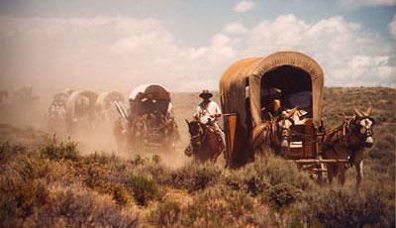
I. Three Trails Heading West
The Oregon Trail
-Independence, Missouri to Oregon Country -People started following the trail to settle in the 1830’s.
-Among the first settlers were missionaries who went to bring Christianity to the Cayuse people at the present site of Walla Walla. They were led by Dr. Marcus Whitman. However, all in this group were killed.

Slide 3
The Oregon Trail Cont.
The Journey was 2000 miles long.
Prairie Schooners-Canvas covered wagons used by Western settlers.
The Oregon Trail crossed The Great Plains, Platte River, Rocky Mountains, Snake River, and Colombia River.

Slide 4
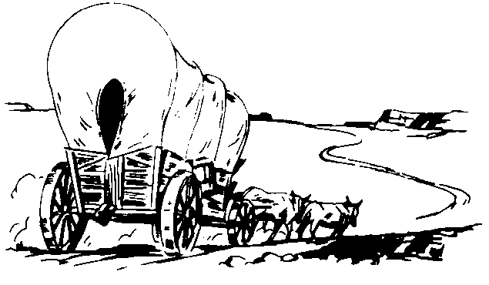
Oregon Trail Cont.
-Many people died – an estimated 10 deaths per mile.
Manifest Destiny-America’s goal of spreading over the entire continent coast-to-coast.
- “Fifty-Four Forty or Fight” Polk’s campaign slogan in 1844. Wanted Oregon from Great Britain. Ended up settling at 49 degrees N.

Slide 5
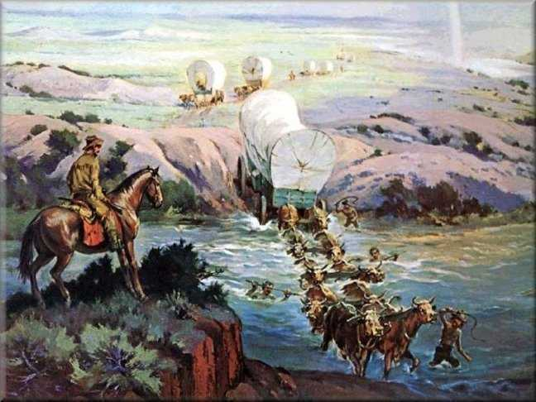
B. The Santa Fe Trail
Independence, Missouri to Santa Fe New Mexico
900-mile trail
The trail was created as a trade route by William Becknell. They hadn’t planned to settle.
As trade increased American’s began settling in the area. Many started to believe that New Mexico as part of Manifest Destiny.

Slide 6
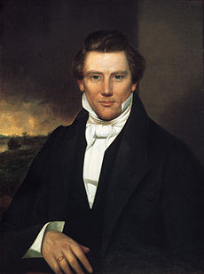
C. The Mormon Trail
Mormons or members of the Church of Latter-day Saints, started in the 1830s and 1840s.
Joseph Smith was the founder of the Mormon church. He published the Book of Mormon in 1830.
He said that he had received a vision to build a new church.

Slide 7
The Mormon Trail Cont.
Many disagreed with Smith’s new ideas such as: Polygamy, the idea that a man could have more than one wife, and that property should be held in common rather than belong to individuals.
Mormons eventually gave up the idea of polygamy.
Mormons were forced from New York and settled in Nauvoo Illinois.
In 1844 Smith was killed by a mob and Brigham Young took over has head of the Mormons.

Slide 8
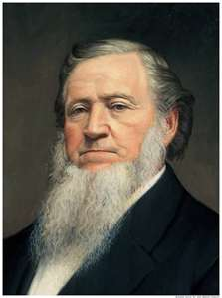
The Mormon Trail Cont.
He decided to move to the Salt Lake region in Utah.
About 12,000 followed him on the Mormon Trail.
They called their new home Deseret and set up farming communities.
Utah became a state in 1896.
Why did the Mormons travel to Utah?

Slide 9
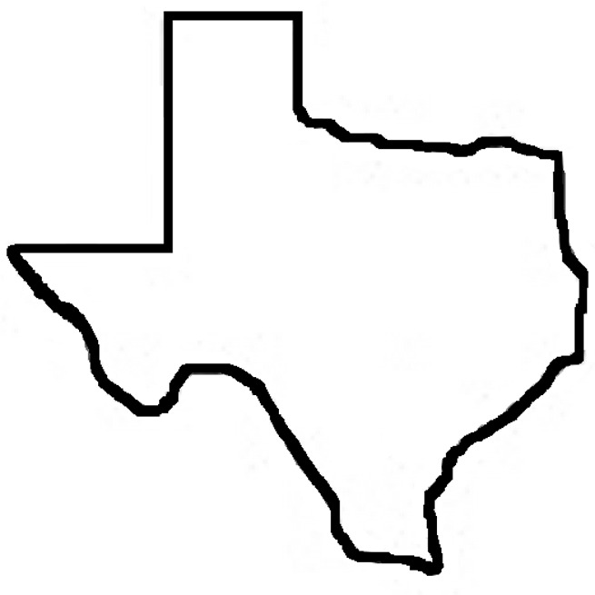

Slide 10
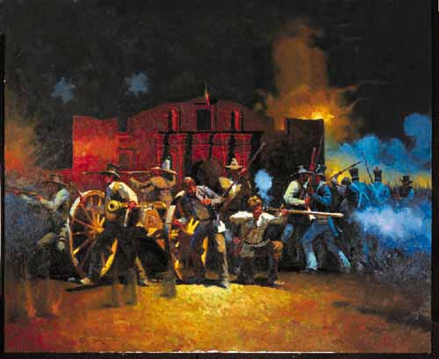
Independence for Texas
-When did Florida become a State?
March 3, 1845
-What other State had to be added to keep the balance of free/slave states?
Iowa

Slide 11
Independence for Texas
Much like the U.S. what did Mexico have to win from a European power?
Independence
Define Tejanos:
Mexican’s who claimed Texas as their home.
Who was the first American to bring families to settle in Texas?
Stephen F. Austin

Slide 12
Land Grants Cont.
How many families joined him?
300
Four requirements to move to Texas
1. Learn Spanish
2. Become Mexican citizens
3. Convert to Catholicism
4. Obey Laws of Mexico-No Slaves

Slide 13
Growing Tension
In 1830 – Americans greatly outnumbered Tejanos.
Worried that they would lose Texas, Mexico issued a Decree-An Official order that stopped all immigration from the U.S.
Sam Houston was sent to Mexico to make peace, but those efforts failed. Many Texans, including Tejanos began planning to break away from Mexico.
Who was President of Mexico?
-Antonio Lopez de Santa Anna

Slide 14
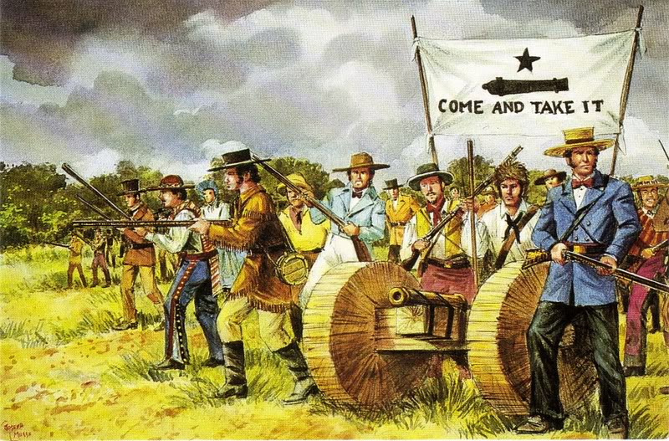
Part II: Texas Revolution
1. The Alamo
December 1835
-Texans captured San Antonio from a larger Mexican force.
-This enraged Santa Anna who found a small Texan force barricaded in a mission called the Alamo.

Slide 15
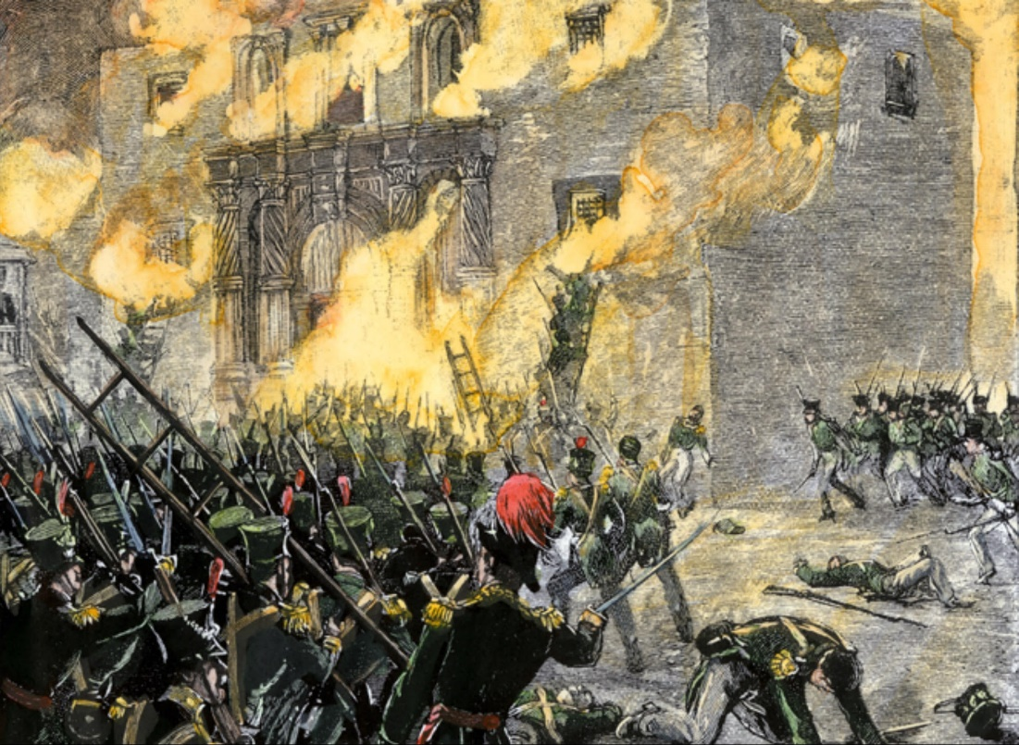
The Battle of the Alamo
180 total soldiers took on several thousand Mexican soldiers.
The Texan forces included:
1. Davy Crockett
2. William B. Travis
3. Jim Bowie

Slide 16
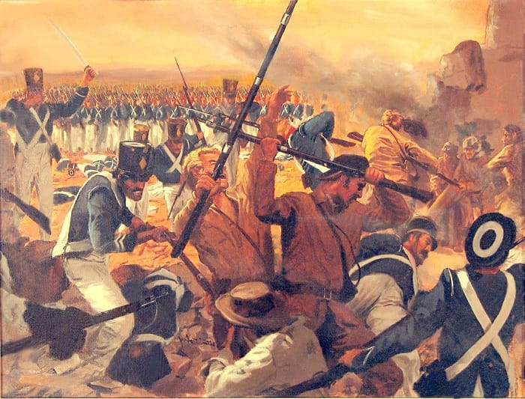
The Alamo Continued
The Battle lasted 13 days
In the end all of the defenders were killed
Only a few women and children survived.
Instead of scaring the Texans, the Alamo provided them with a rallying cry: “Remember the Alamo!”

Slide 17
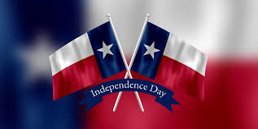
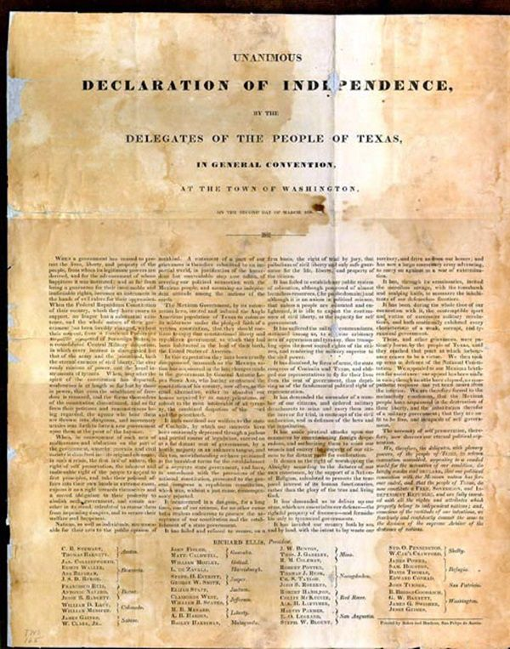
2. Independence
Texans declared independence on March 2 of 1836.
Who was made Commander-In-Chief of the Texan forces:
Sam Houston

Slide 18
The Battle of San Jacinto
The Texan army consisted of 900 troops vs a Mexican army of 1300 troops.
On April 21, the Texans launched a surprise attack shouting, “Remember the Alamo”. They killed more than 600 troops and captured 700 including Santa Anna.
On May 14, 1836, Santa Anna signed a treaty recognizing Texas as independent.

Slide 19
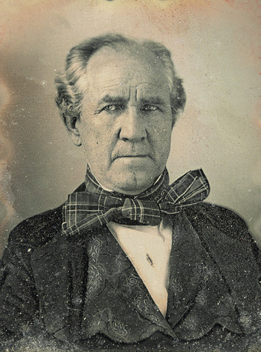
The Lone Star Republic
Who was Texas’ first President?
-Sam Houston
Vice President?
-Mirabeau Lamar
Define Annex:
-Take control of
Why did President Andrew Jackson refuse to add Texas as a state?
-Didn’t want to change balance in Congress
Finally, in 1845, President Polk annexed Texas as a State. The South got Texas as a slave state and the North would get Oregon.

Slide 20
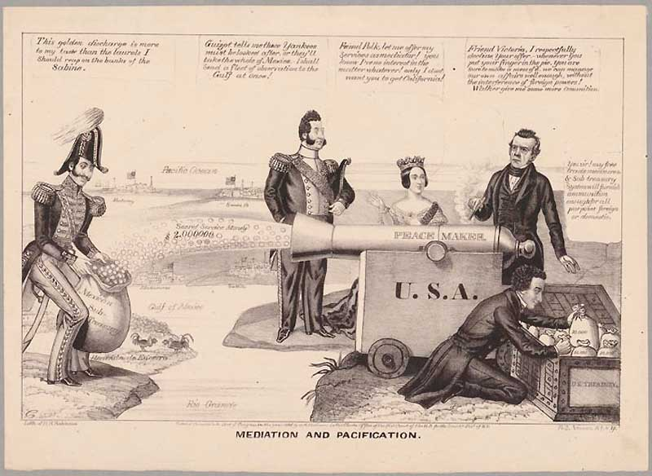

Slide 21
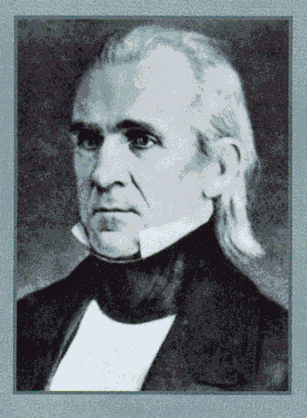
3. War with Mexico Ch. 13/3 1846-48
President Polk saw New Mexico and California as part of the U.S., Mexico didn’t.
The big issue was the border between Texas and Mexico
U.S. thought the Rio Grande River was the border
Mexico thought the Nueces River was the border.

Slide 22
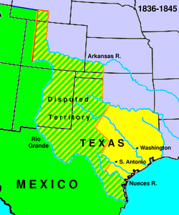

Slide 23
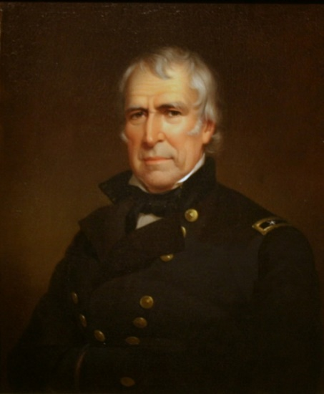
Conflict Begins
How much money did the US offer for California and New Mexico?
-$30 Million
Who offered this money to Mexico?
-John Slidell
Did Mexico accept the offer?
-No
Which future president was sent to protect the border of Texas?
-Zachary Taylor

Slide 24
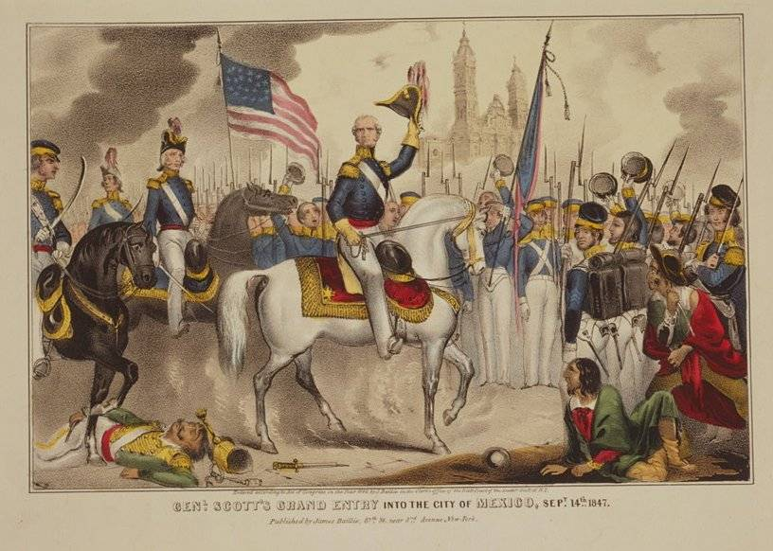
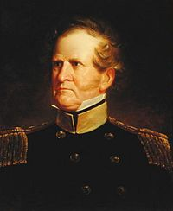
Polk’s War Plan
On May 13, War was declared on Mexico!
Three-part plan
Drive Mexican forces out of Texas-Taylor took border in 1847.
Seize New Mexico and California-Stephen Kearney marched along Santa Fe Trail and took all Mexican cities.
Attack Mexico City-Winfield Scott marched from Veracruz to Mexico City.

Slide 25
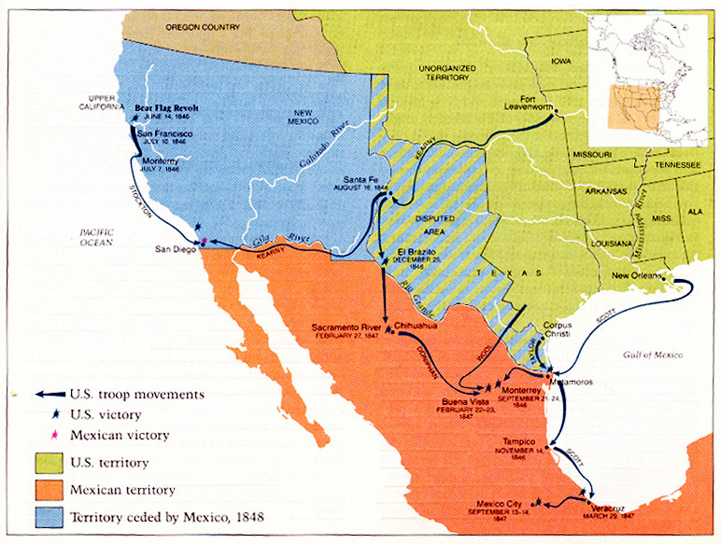

Slide 26
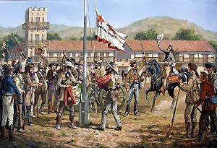
The Bear Flag Republic
The Bear Flag Republic was the nickname for what present day state?
-California
Who encouraged this uprising?
-John C. Fremont
When did the Bear Flag Republic gain its independence?
-June 14, 1846

Slide 27
End of the War
What treaty ended the war?
-Treaty of Guadalupe-Hidalgo
Three Results
Mexico accepted Rio Grande as border of Texas.
$15 million for the Mexican Cession (New Mexico and California)
$10 Million for Gadsden Purchase
What was the last purchase of the contiguous United States called? Gadsden Purchase
How much did it cost? 10 Million

Slide 28
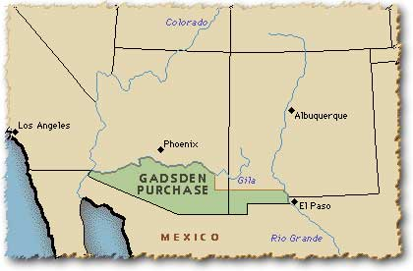

Slide 29
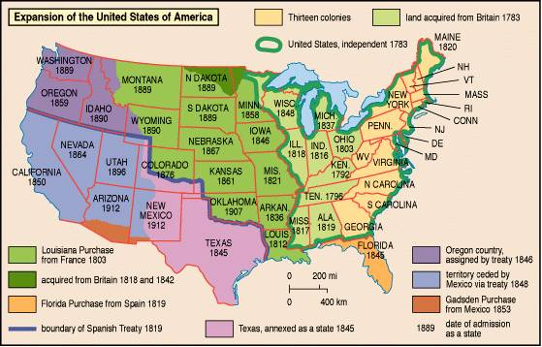

Slide 30
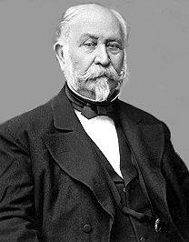
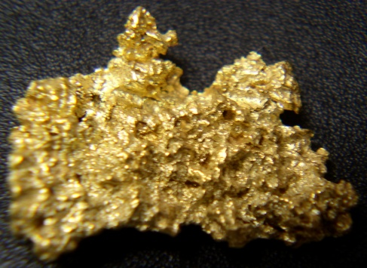
California
Where and when was gold first discovered in California?
-Sutter’s Mill 1848
What did they call the gold speculators who first came to California and why did they call them this?
-1849 was when many 1st went, so they were called 49ers.
What is a Californio?
-Mexicans who lived in California

Slide 31
California Gold Rush
What happened to the Californios’ land due to the Land Law of 1851?
-Many lost their land because US citizens claimed it and courts supported US citizens.
What was a “boomtown”?
-Towns that sprang up quickly
Were most 49ers experienced miners?
-No
Describe how miners would find gold.
-Find out where gold was and dig w/pickaxe or pan in rivers.

Slide 32
Life in California
What effect did the gold rush have on the world’s supply of gold?
-Doubled
How much gold did most miners find?
None
Who really made money on the gold rush?
-Merchants
List one person who benefitted greatly from the gold rush.
-Levi Strauss-blue jeans

Slide 33
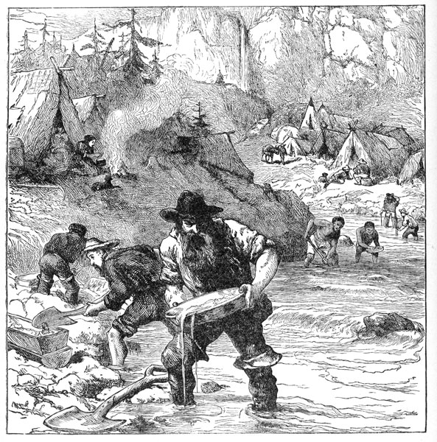
Gold Rush Society
Mostly men. Lonely, lots of drinking, gambling, and fighting. Vigilantes were used as police and typically took the law into their own hands.
Female-Very few women and most would be married. Some worked in saloons and other entertainment venues. Many worked the gold mining fields right along side the men.

Slide 34
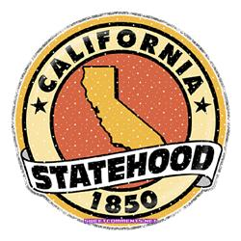
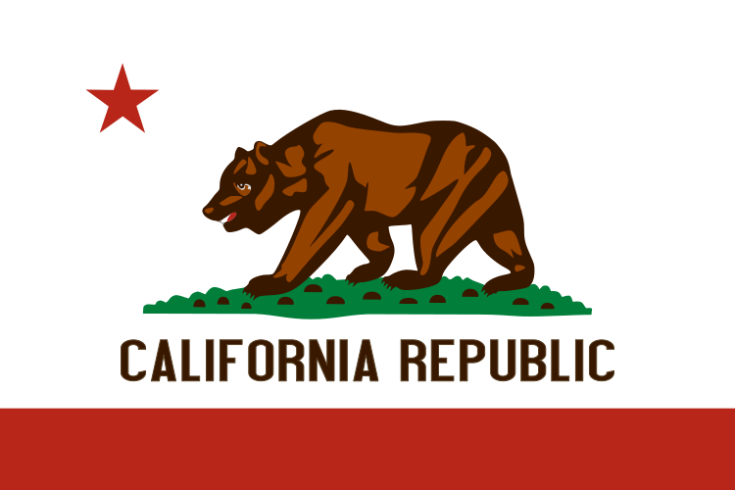
Economic and Political Progress
California applied for statehood in 1849. They wanted to be a free state but again this made the U.S. Congress fight over adding another State. In the end, a compromise was reached and California would become a state in 1850.

