Slide 1
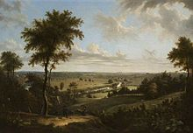
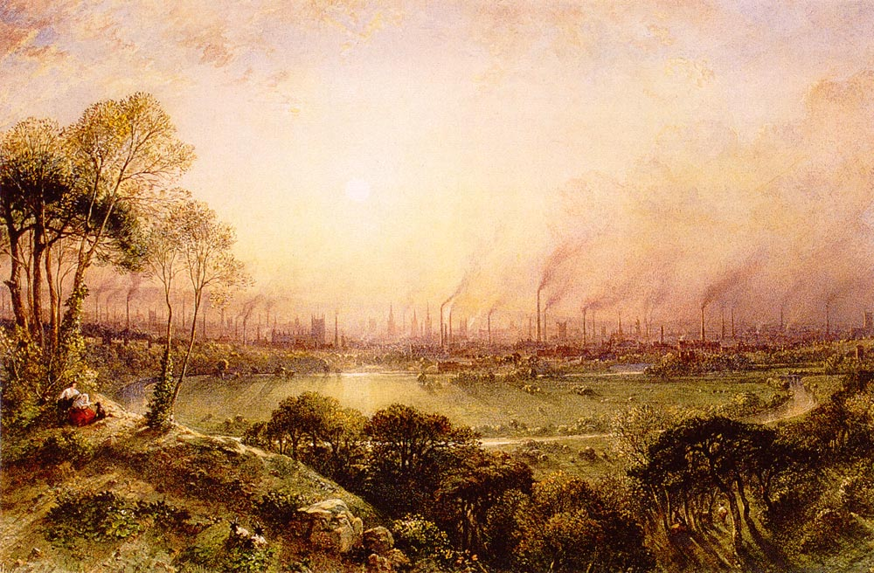
Unit 7 (Chapter 11)
Growth and Expansion

Slide 2
James Hargreaves-England 1764
Spinning Jenny
Spin several spools of thread at once.
Produces thread spools much faster saving people time=Cheaper thread.

Slide 3
Edmund Cartwright-England 1784
Power Loom
Machine run loom. Run with water power at first.
Cloth produced cheaper and increased need for cotton.

Slide 4
Samuel Slater-US 1793
1st American Mill
Same as England. Used to produce textiles.
Brought us up to speed with England.

Slide 5
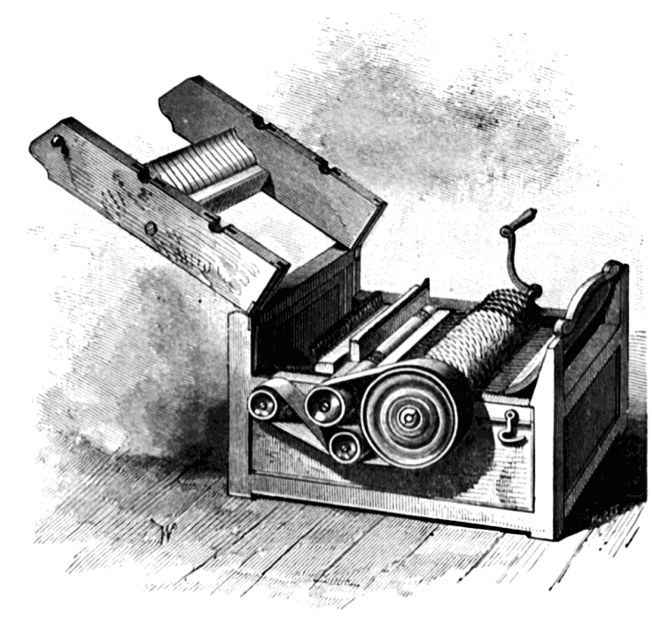
Eli Whitney
Cotton Gin -1794
(Interchangeable Parts -1801)
Description: Machine used to Separate seeds from cotton
Effect: Cotton now more profitable because it could be processed faster.
(Guns now mass produced)

Slide 6
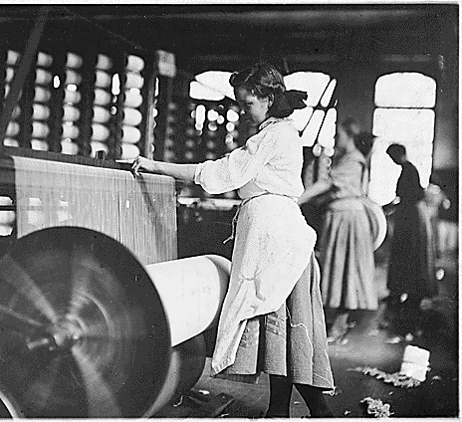
Francis Cabot Lowell
Lowell Mills-1821
Mill that combined the spinning and weaving of fabrics.
Impact: Lowell, Mass. Developed into a factory town. Other factories followed and perfected textile industry.

Slide 7
3 phases of the Industrial Revolution
Employers divided jobs into smaller steps.
Entrepreneurs built factories to bring specialized workers together.
Workers used machines to complete tasks.

Slide 8
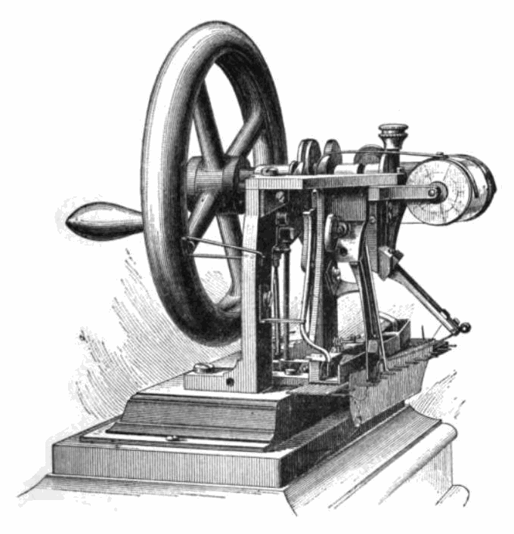
Elias Howe
Sewing Machine-1846
Description: Machine that could produce 250 stitches a minute.
Effect: Sped the production of clothing. Made clothes cheaper to buy.

Slide 9
John Griffiths US 1845
Clipper Ships
Transport ships with higher mast and bigger sails.
Faster shipping and transportation to Europe.
Short lived as steam power was coming.

Slide 10
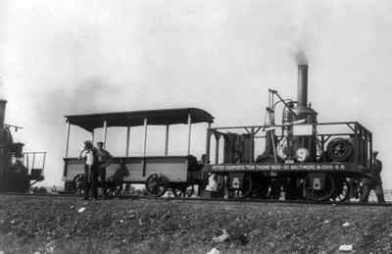
Peter Cooper
1st Steam powered Locamotive-1830
Description: Steam powered train engine that could send goods across land faster.
Effect: Lead to one of the greatest Revolutions in transportation in history.

Slide 11
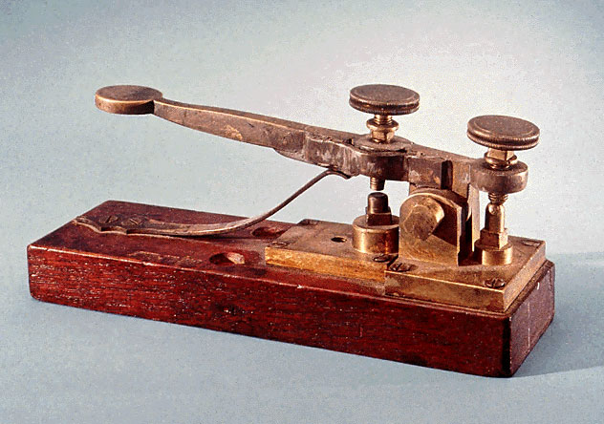
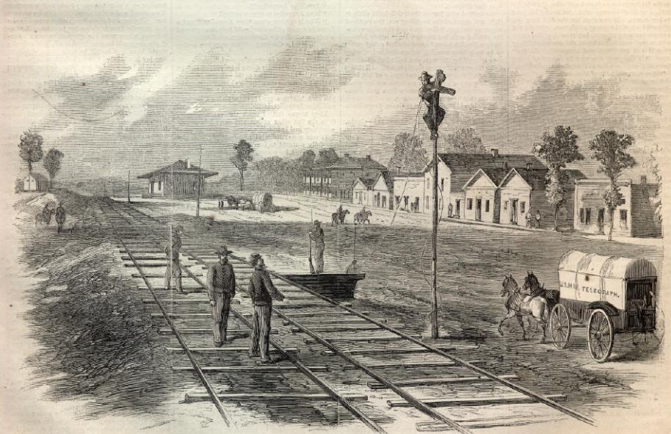
Samuel F.B. Morse
Telegraph (Morse Code) 1830s
Description: Sent messages using “morse code” across the country.
Effect: Communication sped up considerably.

Slide 12
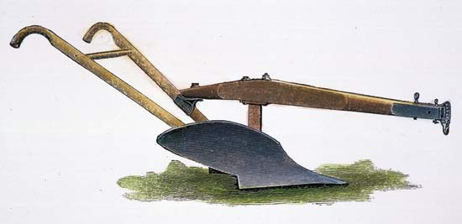
John Deere
Steel Plow-1840s
Description:
Plow made of steel☺
Effect: Could now plow land faster/easier.
Lead to more people moving west and more land farmed.

Slide 13
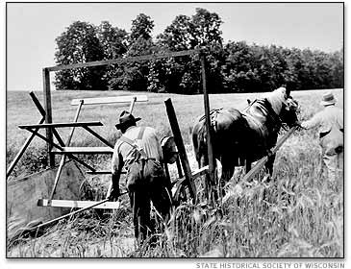
Cyrus McCormick
Mechanical Reaper-1831
Machine used to cut down crops faster
Fewer farmers and more crops

Slide 14
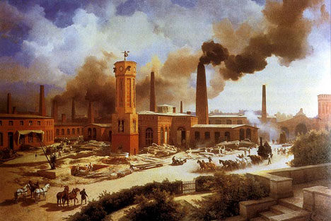
I. The Industrial Revolution
The Growth of Industry
In the early 1700s, where did most people live and work?
Farms
The way goods were made began to change because of inventions in what country?
Great Britain
In your own words, what is the definition of the Industrial Revolution?
Effect?

Slide 15
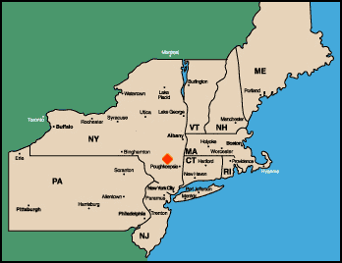
Industrial Revolution in New England
Revolution began in the US
around 1800
Why New England?
Regions Geography
Farming was difficult in New England poor soil
Had rivers/streams to provide water power needed to run machines in new factories.

Slide 16
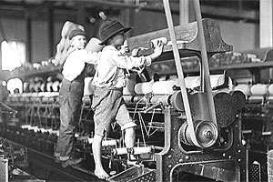
Patents and Factories
Patent-
Gives the sole legal right to the inventor and its profits for a certain period of time.
Name two men who began the textile industries in America.
Samuel Slater
Francis Cabot Lowell
What are textiles?

Slide 17
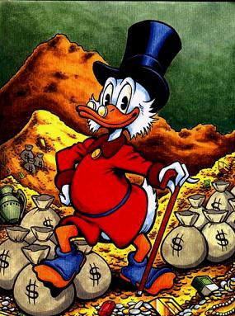
Free Enterprise
Define Capitalism-
The economic system of the US
Define Capital-
Money invested in a business
Define Free Enterprise
People are free to buy, sell, and produce whatever they want

Slide 18
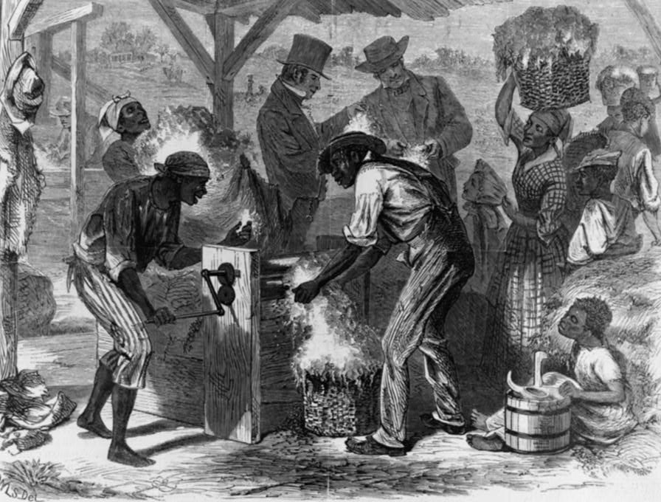
Agriculture Expands
What direction were farmers moving?
West
What types of crops did they raise in the Ohio River region?
Corn, Wheat, Pork
What crop rose steadily with the rise of the textile industry?
Cotton
Who did Southerners use to plant, grow and harvest cotton?
Enslaved workers from Africa
What invention led to this?
Cotton Gin

Slide 19
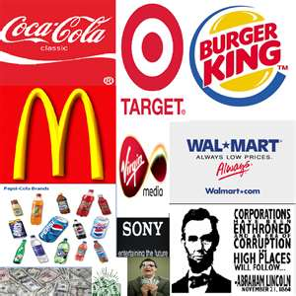
Economic Independence
What did many shopkeepers, merchants, and farmers do with their money?
Invest in new businesses
Corporations Develop
What is another name for large businesses?
Corporations

Slide 20
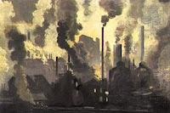
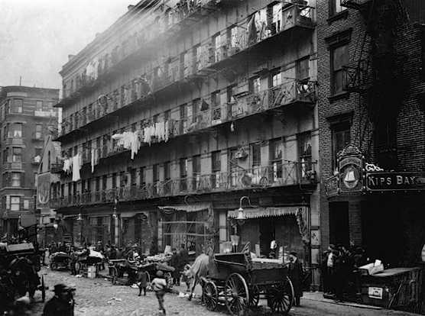
Cities Grow Up
The growth of factories and trade led to the growth of?
towns and cities
What are three of the US’ oldest cities?
New York
Boston
Baltimore
What three westward cities grew because they were located along rivers?
Pittsburgh
Cincinnati
Louisville
Describe these cities.
Wood/brick buildings, unpaved streets, no sewers, fire. Lots of opportunities though.

Slide 21
II. Moving West
The first ever census –count of a population- took place in 1790 (our country does a census every 10 years)
Population= 4 million people (most people lived between the Atlantic Ocean and the Appalachian Mountains)
A Change Occurs= during the 1800’s thousands of settlers began heading west of the Appalachians.

Slide 22
Daniel Boone
Explorer Daniel Boone was among the early western pioneers.
He led a group to clear a path through the Cumberland Gap leading into Kentucky.
It created a shortcut through the Appalachian Mountains.
This came to be known as the Wilderness Road and more than 100,000 people traveled it between 1775 and 1790.

Slide 23
Building Roadways
Private companies built turnpikes-toll roads where travelers had to pay to travel.
The first nationally funded road west was called National Road.
It started in Cumberland, Maryland and ended in Vandalia, Illinois.

Slide 24
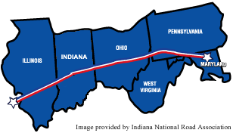
National Road: 1806-1818
Year | Ohio | Indiana | Illinois
1800 | 42,159 | 2,632 | 2,458
1810 | 230,760 | 24,520 | 12,282
1820 | 581,434 | 147,178 | 55,211
1830 | 937,903 | 343,031 | 157,445

Slide 25
Building Roadways Cont.
River travel was much easier and people could carry larger loads BUT
1. Most rivers flowed North/South and people wanted to go East/West.
2. Traveling upstream was very difficult

Slide 26
Building Roadways Cont.
The invention of the steam engine, such as the Claremont by Robert Fulton, helped with travelling upstream but man-made canals would need to be built to go East/West.
Canals- artificial waterway
The Erie Canal was the first of many major canals to be built. Lock Video
Dewitt Clinton developed this canal to connect Lake Erie to the Hudson River.

Slide 27
Westward Expansion cont.
By 1820-the population was more than 2.5 million west of the Appalachian Mountains.
1791-1820: The following States were added Vermont, Kentucky, Tennessee, Ohio, Indiana, Illinois, Mississippi, Alabama, and Louisiana.

Slide 28
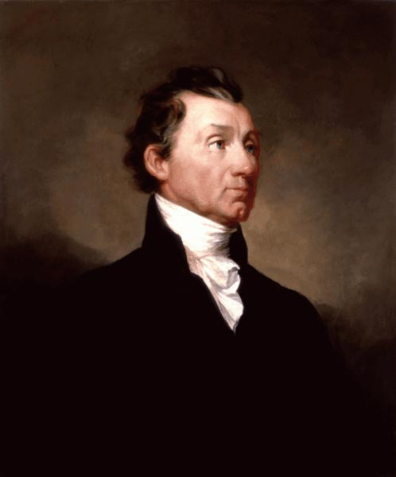
III. Unity and Sectionalism
What did they call the period that followed the War of 1812
The Era of Good Feelings
Who was President?
James Monroe
What had James Madison pushed for in his final message to Congress in 1817?
Increased power of the Federal Gov.

Slide 29
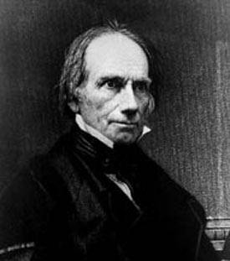
American System
Was developed by Speaker of the House?
Henry Clay
What was the goal of the American System?
Help the Economy throughout the entire country.
List the three parts of this plan:
1. Higher Tariffs (Help the North)
2. New Bank of the US
3. Internal improvements: roads, bridges, canals

Slide 30
Tariffs
How did the Tariff plans of 1816, 1818, and 1824 divide the nation between North and South?
The tariff plans each raised taxes on imports higher and higher. Was designed to protect American industry
South didn’t have much industry so they were against these tariffs. They had to pay higher prices for goods too

Slide 31
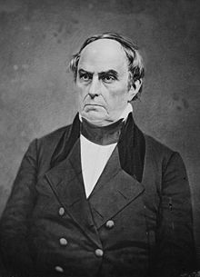
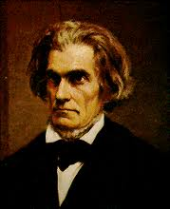
Three major sections
Northerners-Manufacturing, Trading, Abolitionist movement. (Daniel Webster)
Southerners-farming cotton, maintaining their state rights to own slaves. (John C. Calhoun)
Westerners-roads, conflicts with Native Americans, becoming free or slave states. (Henry Clay)

Slide 32
Supreme Court Flexes Muscles
Fletcher v. Peck 1810
Allowed SC to overturn State acts if they were against the Constitution.
McCulloch v. Maryland 1819
Stopped Maryland from taxing the US Bank. Bank=Constitutional
Gibbons v. Ogden 1824
Stopped NY from setting up a trade monopoly with NJ.

Slide 33
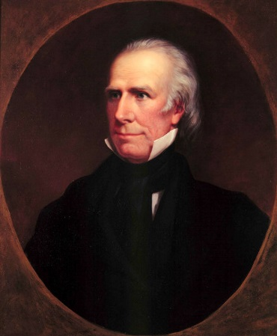
Missouri Compromise
Henry Clay proposed the Missouri Compromise
Missouri became a slave state
Maine became a free state
Banned slavery in the rest of the Louisiana Territory north of the 36 30 degree North Parallel
1821 there would be 24 states 12 free and 12 slave –balance even in the U.S. for now!

Slide 34
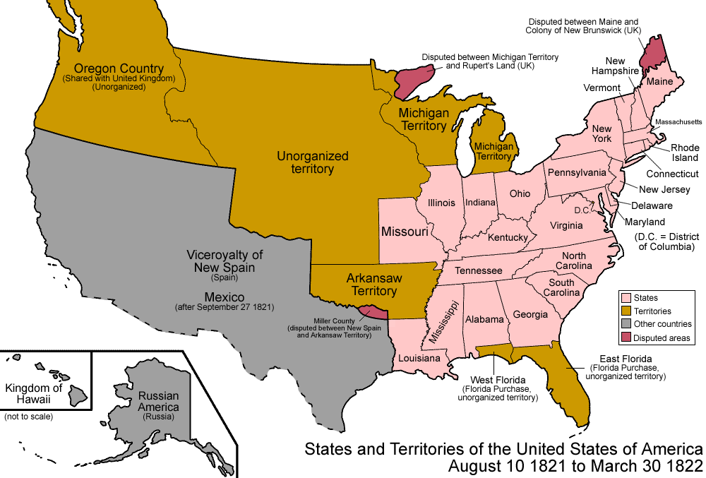

Slide 35
12/12 Split
Slave States
Maryland Arkansas Ter.
Louisiana Florida Ter.
Mississippi
Alabama
Georgia
South Carolina
North Carolina
Tennessee
Kentucky
Virginia
Delaware
Missouri
Free States
Illinois Michigan Ter.
Indiana
Ohio
Pennsylvania
New York
Vermont
New Hampshire
Massachusetts
Rhode Island
Connecticut
New Jersey
Maine

Slide 36
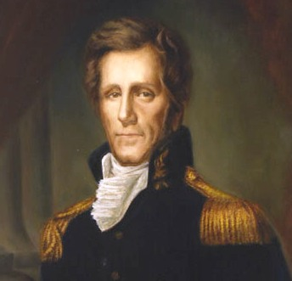
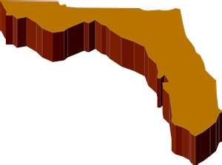
Foreign Affairs
Great Britain
Describe how relations with Great Britain improved in the early 1800s.
-Agreed to limit ships on Great Lakes and set the boarder between US and Canada at the 49th parallel.
Spain
In 1812 the US simply took control of Western Florida and Spain did nothing about it.
Future President Andrew Jackson followed the Seminole Indians into Florida after people in Georgia complained of Indian raids.

Slide 37
Spain Cont.
He proceeded to basically seize the rest of Florida and Secretary of State John Q. Adams did nothing to punish him even though he hadn’t ordered this invasion.
Treaty: Adams-Onis Treaty (We get Florida)
We promised not to go into Texas.

Slide 38
Spain loses its lands in America
Miguel Hidalgo
1810-1821 Mexico
Simon Bolivar “The Liberator”- Venezuela, Colombia, Panama, Bolivia and Ecuador
Jose de San Martin
1824 Chile and Peru

Slide 39
The Monroe Doctrine
-Europeans wanted to get lands that were once controlled by Spain for themselves.
What did it do?
The U.S. would not interfere with any existing European colonies in the Americas
North and South America were closed to European Colonization.
The United States was starting to become a world power.

Slide 40
