Slide 1
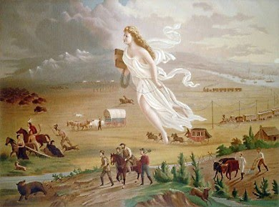
2nd Semester: Westward Expansion
Jeffersonian Era-Lewis and Clark/Louisiana Purchase
War of 1812
Industrial Revolution
Expansion West
Slavery/Causes of
the Civil War
The Civil War
Reconstruction

Slide 2
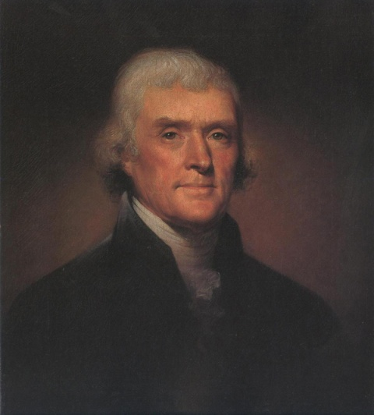
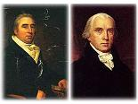
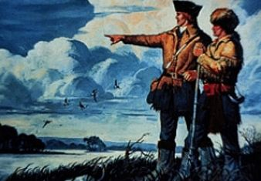
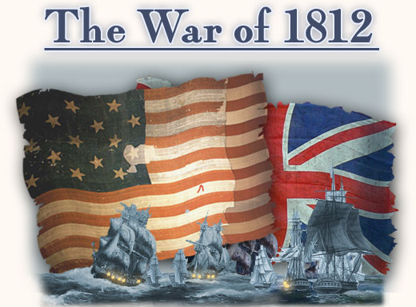
Unit 6: Power Point
The Jeffersonian Era
Thomas Jefferson
Our Judicial System
Westward Expansion-Louisiana Purchase and Lewis & Clark
The War of 1812-Madison Presidency

Slide 3
I. Thomas Jefferson
The Election of 1800
Federalist-John Adams
VP-Charles Pinckney
Dem.-Rep-Jefferson
VP-Aaron Burr
Problem-
Jefferson and Burr tied for 1st!!!
-Constitution says that the House of Representatives must vote to decide the election in case of a tie.
-They voted 36 times before Jefferson was selected to be the 3rd President.
-Hamilton persuaded Federalists to support Jefferson.
-A few years later Burr killed Hamilton in a Duel.
*Jefferson’s Inauguration: Wore plain clothes and Adams didn’t attend.

Slide 4
Changes!!!
12th Amendment
-Changed the way Electors voted for the President.
-Now the President and Vice President are listed together on the ballot.
Attack Ad
Commercial

Slide 5
President Jefferson
Had many talents and achievements lawyer, architect, inventor, violinist, scientist, farmer, and politician
Wanted to Decrease the power of the Federal government. “Laissez-Faire”- Let people do as they choose
He cut cost by reducing the Military and the number of federal workers.
Repealed most taxes.

Slide 6
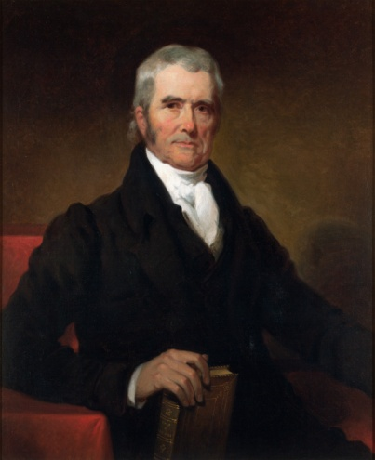
II. Judicial Branch Emerges
Judiciary Act of 1801
Passed prior to Jefferson taking office
Created regional courts with 16 judges
Adams filled these seats with Federalists prior to leaving
Not all papers were filed though, and Jefferson told Madison not to deliver the papers.
John Marshall
Chief Justice
Marbury v. Madison
Marbury was supposed to get one of the jobs assigned by Adams.
He took his case to the Supreme Court.
The Supreme Court ruled that it didn’t have jurisdiction to intervene but established Judicial Review (Declaring Acts of the government constitutional or not) and the Supremacy of the Constitution.

Slide 7
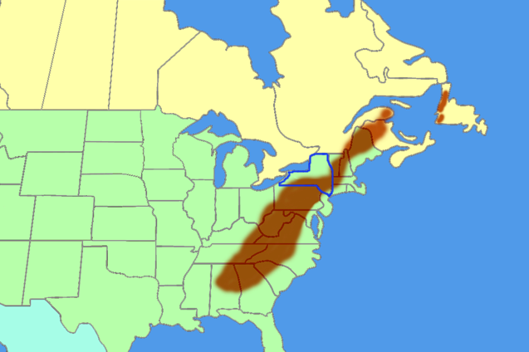
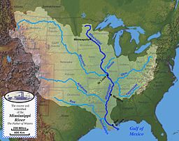
III. Westward Expansion The West in 1800
The Appalachian Mountains
*Spain controlled the land West of the Mississippi
*To the Mississippi River

Slide 8
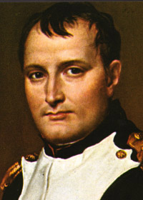
Louisiana Purchase
French Emperor Napoleon Bonaparte wanted to expand his empire. Even into America.
He needed Money for his military campaigns against Britain 1^{st.}
Live Footage
Jefferson sent Monroe and Livingston to France and they were offered the entire Louisiana Territory.
Oct. 1803 the purchase was approved for 15 million dollars three cents an acre.
Doubled the size of the United States.

Slide 9
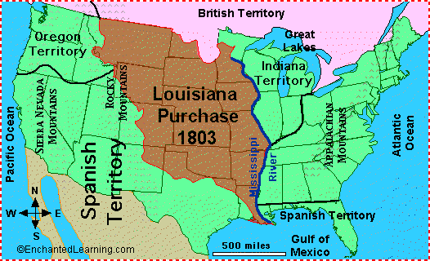
The Louisiana Purchase

Slide 10
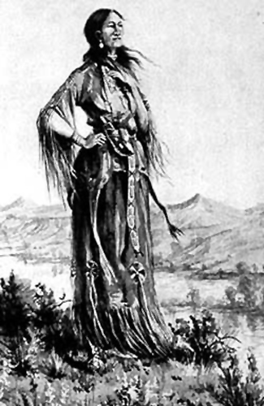
Lewis and Clark
The Lewis and Clark Expedition, or the Corps of Discovery (1804-1806)
Goals of the Expedition
Document findings about the territory.
Learn about the people, plants, and animals.
Find if there is a Northwest Passage across North America.
Establish good relations with different Native American tribes.

Slide 11
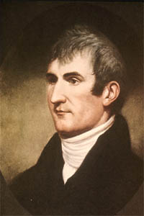
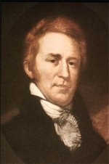
Lewis and Clark
Meriwether Lewis & William Clark
Other Names:
-Sacagawea- Shoshone woman who helped guide the expedition
-York-enslaved African American, who was very important to the expedition because many of the Indians hadn’t seen an African American before.
-Charles Floyd-the only member to Die on the Expedition. He is buried on the Missouri River outside of Sioux City. (Floyd’s Bluff)
*It took 18 Months to get to the Pacific Ocean. The expedition inspired others to move westward.

Slide 12
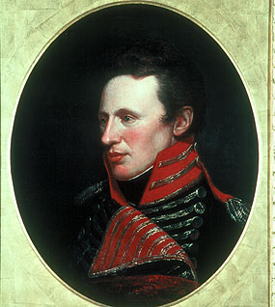
Other Expedition’s and Happenings
Pike’s Expedition
-Lieutenant Zebulon Pike
-Explored the Great Plains and Rocky______ Mountains.
Hamilton’s Death: July 11, 1804
-Killed by Aaron Burr in a duel. -Hamilton had accused Burr of plotting treason. He also had hurt Burr’s political career.
-Burr challenged Hamilton to a duel and fled after defeating him.

Slide 13
Jefferson’s Foreign Affairs
*War with Tripoli
-the US refused to pay tribute money to the Barbary States (Tripoli, Morocco, Algiers, and Tunis) because they harbored _Pirates.
-Tripoli declared war, which ended in 1805.
The US made a deal with Tripoli, but still paid the other Barbary States until 1816.
*England/France
-Jefferson remained Neutral in this conflict. Both were irritated by this.

Slide 14
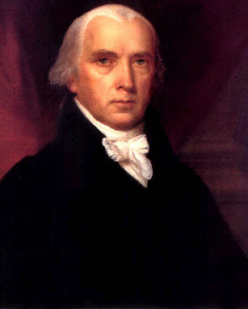
James Madison-1808
*1808-Jefferson follows Washington’s lead and leaves office.
*Election of 1808-
Democratic-Republican-James Madison defeated Federalist Charles Pinckney.
*Madison’s Presidency will be ruined by the embargo Crisis and War with Great Britain.

Slide 15
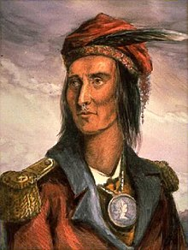
Broken Treaties
Settlers were moving into lands occupied by Native Americans in the Ohio River Region. This was even after they had given millions of acres.
Two Native American’s were threatening to join forces with the British. They were Tecumseh and his brother The Prophet.

Slide 16
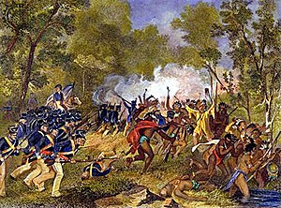
Broken Treaties Cont.
Following the Battle of Tippecanoe, where William Henry Harrison gained his fame by defeating The Prophet, Tecumseh joined forces with the British in the area.

Slide 17
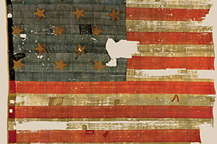
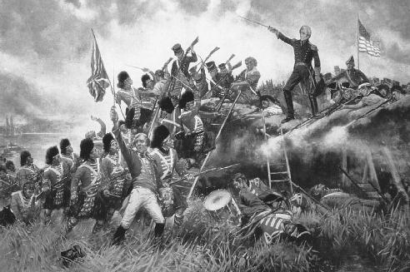
Causes
Great Britain and France were at war
Great Britain was mad at America for giving supplies to France and placed a trade Embargo on the US.
Young D-R’s known as War Hawks lead by Henry Clay and John C. Calhoun pushed for war.
WAR is Declared!!!!
Other names for the War of 1812: The Second War for Independence or Mr. Madison’s War

Slide 18
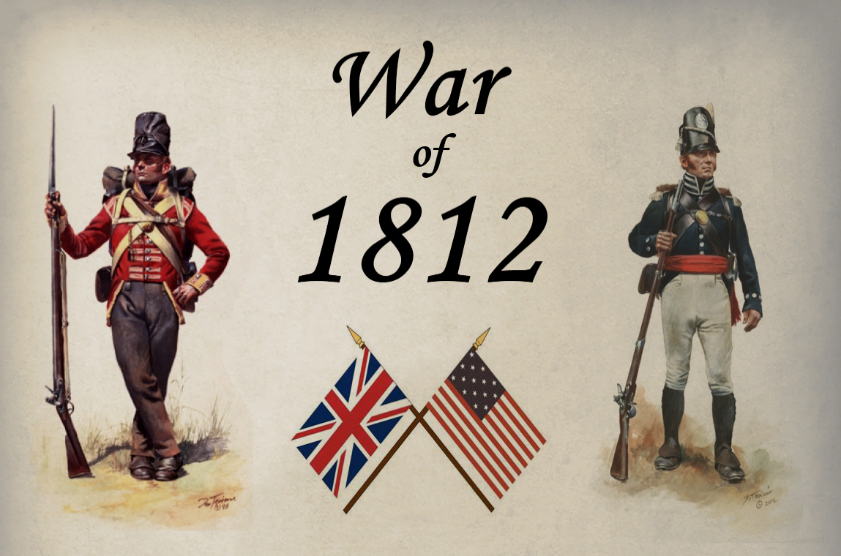
Phases of the War
Phase 1: American success on Great Lakes
Early on America was unprepared for war.
We only had 12,000 Soldiers.
Most of our “army” was made up of the 50,000-100,000 poorly trained militia.
The British were busy with France and relied heavily on their Native American allies.
The US realized that to have success they had to take over Lake Erie.

Slide 19
Phase I Continued: Battle of Lake Erie
Unlike the Revolution the US had 3 of the fastest frigates (warships). The USS Constitution was the most successful of these.
Oliver Perry commanded this ship and won a key battle on Lake Erie in 1813. “We have Met the Enemy and they are ours” is his famous quote that came from this battle.

Slide 20
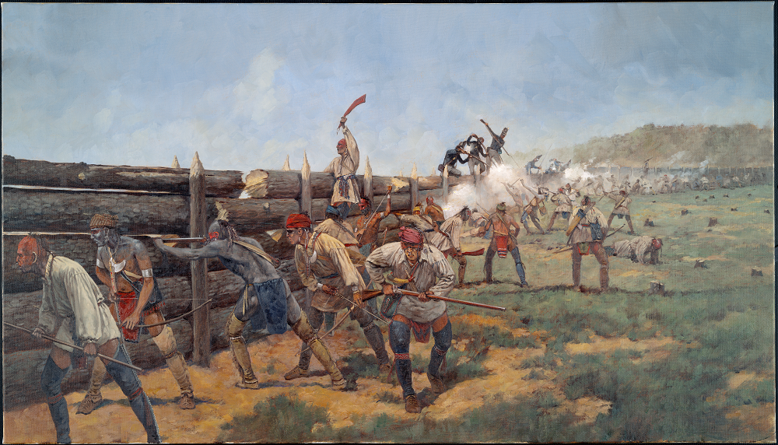
Phase 1 Continued: Other Wins
The famous Native American leader Tecumseh was killed by William Henry Harrison’s men at the Battle of the Thames. This brought an end to the confederation Tecumseh had planned with the Creeks.
In 1814 future President Andrew Jackson defeated the Creeks at the Battle of Horseshoe Bend.

Slide 21
Phase 2: British Offensive
Great Britain sent more forces to America after defeating the French in 1814.
Washington DC was attacked in 1814 and the militia was easily defeated. The Capital Building and the White House were burnt down. It would have been worse had a storm not put out the fires.

Slide 22
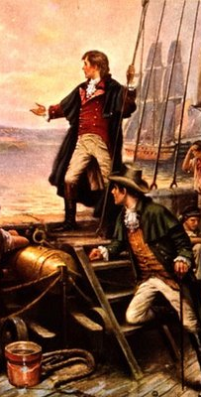
Three Major Victories for America
Fort McHenry
Baltimore, Maryland
Great Britain bombarded the American fort all day and night but were not able to take it.
While being held captive by the British, Francis Scott Key wrote a poem about the battle.
The Star-Spangled Banner became our national anthem on March 3, 1931.

Slide 23
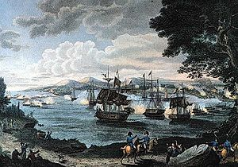
Major Victories Cont.
Plattsburgh
-The British brought 10,000 soldiers to attack the city of Plattsburgh, New York.
-The American Navy defeated the British on Lake Champlain forcing them back into Canada.
-This battle convinced the British that the war was too expensive.

Slide 24
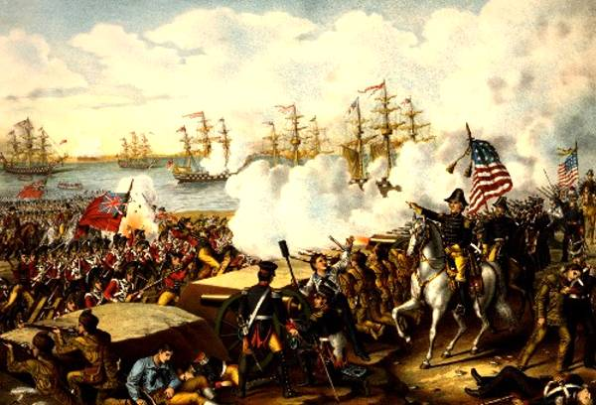
Major victories continued
3. Battle of New Orleans
-The greatest American victory of the war, but wasn’t necessary because a peace agreement had already been reached.
-Future president Andrew Jackson led the attack with the support of the citizens of New Orleans.
-Only 71 Americans died in the battle compared to over 2,000 British.

Slide 25
The War is Over
Treaty of Ghent -treaty that ended the War of 1812.
Effects of the War
1. Increased American Patriotism
2. Weakened Native American Resistance
3. Growth of US Manufacturing

