Slide 1
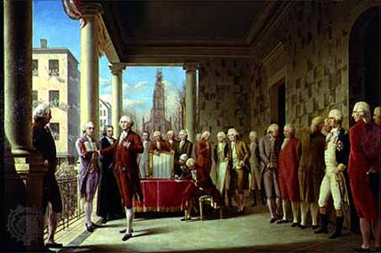
Unit 5 Ch. 8
“The Federalist Era”

Slide 2
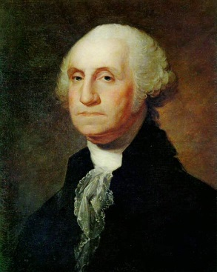
I. The First President
April 30, 1789, George Washington took the oath of office as first president of the United States.
Washington knew precedents he set would shape the future of the US.
Three Accomplishments of 1st Congress!!!
1. Washington created departments within the Executive Branch, 2. set up the court system and 3. added the Bill of Rights to the Constitution.

Slide 3
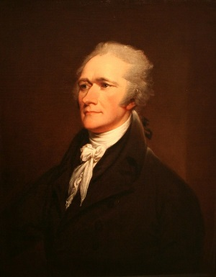
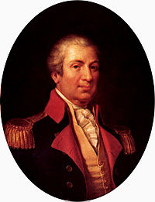
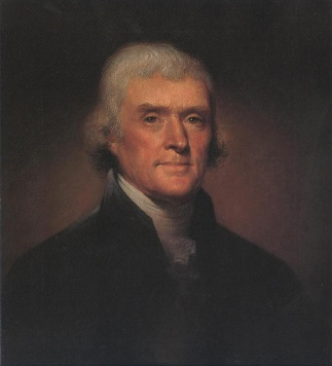
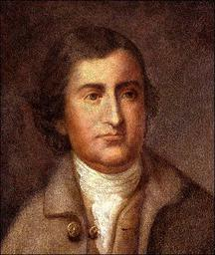
The First Congress
1. Congress set up 3 departments and 2 offices in the Executive Branch.
State Department-led by Thomas Jefferson
Department of the Treasury-Led by Alexander Hamilton
Department of War-led by Henry Knox
Attorney General-Edmund Randolph

Slide 4
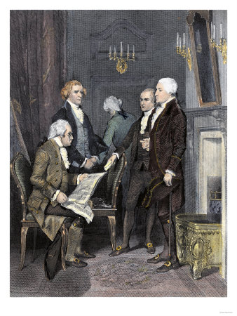
The First Congress Continued
These three department heads and the Attorney General became known as the Cabinet.
Congress decided the president had authority/Power to dismiss cabinet members without Senate approval

Slide 5
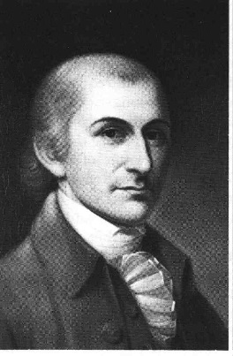
2. Judiciary Act of 1789
Compromise was reached on establishing the court system with this Act.
States kept their court systems.
Federal courts had the power to reverse state court decisions. The Supreme Court would be the final authority on many issues.
President Washington nominated John Jay to lead the Supreme Court as Chief Justice.

Slide 6
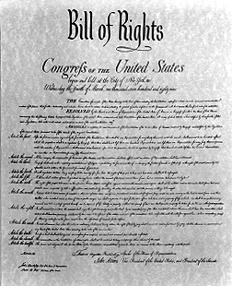
3. The Bill of Rights
The Bill of Rights was introduced this first session of Congress.
It was added to guarantee civil liberties-Protections against the government.

Slide 7
The New Country’s Economy
The new nation faced serious financial problems. The national debt was growing but Alexander Hamilton (Secretary of the Treasury) had a plan.
***Three Major Financial Issues!!!
Debt
National Bank
Taxes/Tariffs

Slide 8
1. Hamilton’s Plan (Debt)
Hamilton asked the House of Representatives to prepare a plan for the “adequate support of public credit”.
This meant that US needed a way to borrow money for its government.
He proposed the US pay off all its war debt.

Slide 9
Opposition to the Plan
Congress agreed that the foreign debt should be paid but didn’t agree that American citizens should be paid off.
During the war, the government had issued bonds (paper notes promising to repay the money in a certain length of time).
Speculators were buying them up for less than their value to make a profit when the government paid them back.

Slide 10
Compromise
To win support of his plan, Hamilton worked out a plan with the Southern leaders (they’d accumulated less debt, so they were against the plan).
The compromise: a special district would be laid out between Virginia and Maryland. It became known as Washington, D.C.
While workers prepared the new city, the Capital was moved from New York to Philadelphia.

Slide 11
2. The Fight over the Bank
Hamilton also asked for the creation of a national bank-The Bank of the US.
This bank would hold government funds and make debt payments.
It created a single form of currency/money for the nation as well.

Slide 12
3. Tariffs and Taxes
Hamilton wanted tariffs (taxes on imports) to raise money and protect new American industries.
The South was opposed because they had little industry, but Congress supported low tariffs.
Hamilton also called for national taxes to help pay off the national debt.
Congress approved a variety of taxes, including one on whiskey distilled in the US.

Slide 13
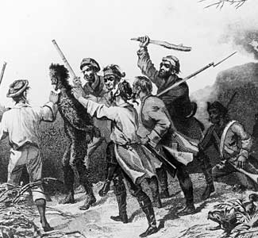
II. Early Challenges
The Whiskey Rebellion and the West
There were many challenges facing Washington and the new government.
In Western Pennsylvania farmers were resisting the tax on whiskey.
Their protest turned violent in July 1794.
An armed mob attacked tax collectors and burned down buildings.

Slide 14
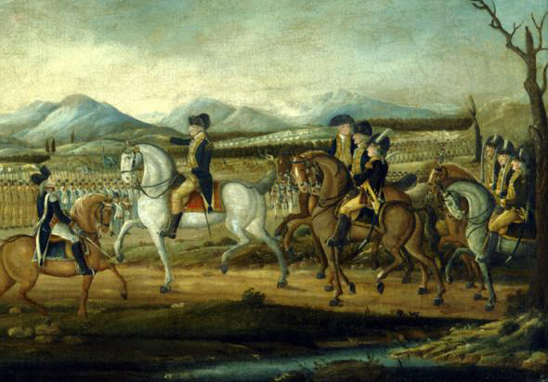
Whiskey Rebellion cont.
The attack alarmed government leaders.
Washington decided to send in federal troops.
This sent the message that the government would use force when necessary to maintain order.

Slide 15
Struggle Over the West
There were worries of European ambitions in the Northwest Territory.
President Washington signed treaties with the Native Americans hoping to lesson the influence from the British and the Spanish.
Americans ignored the treaties and moved into the lands promised to the Native Americans. Fighting broke out between the two groups.

Slide 16
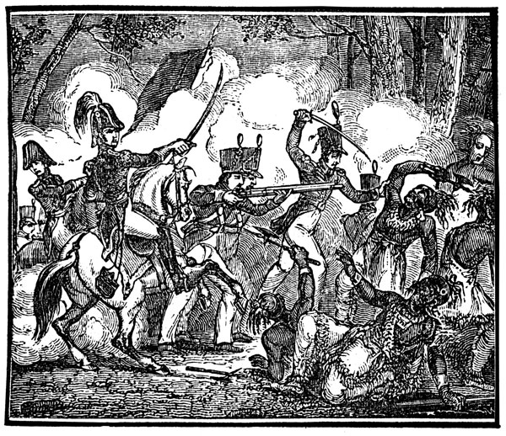
Struggle Over the West Cont.
More than 600 American soldiers died in the battle known as St. Clair’s Defeat in 1791.
Another battle broke out in 1794 and the Americans defeated more than 1000 Native Americans this time.
This was the battle of Fallen Timbers near present day Toledo, OH.
Native Americans’ hopes of keeping their land were crushed.
In the Treaty of Greenville, they agreed to surrender most of the land in what is now Ohio.

Slide 17
Problems with Europe Washington Proclaims Neutrality
The French Revolution erupted in 1789. Britain and France went to war in 1793.
America was hoping to stay neutral (not taking sides).
The French tried to get the US involved.
President Washington issued a Proclamation of Neutrality.
It prohibited Americans from fighting in the war and barred French and British warships from American ports.
The British were capturing any American ships that were trading with the French and forcing American crews into the British navy.
This is called Impressment.

Slide 18
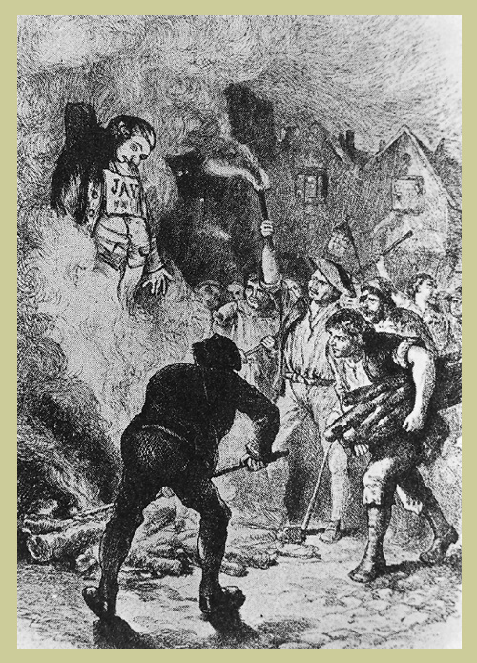
Jay’s Treaty
Chief Justice John Jay was sent to negotiate a peaceful solution with Britain.
The British agreed to withdraw from American soil but impressment wasn’t addressed in the treaty, nor was the problem of the British interference with trade.
Few Americans approved of it.

Slide 19
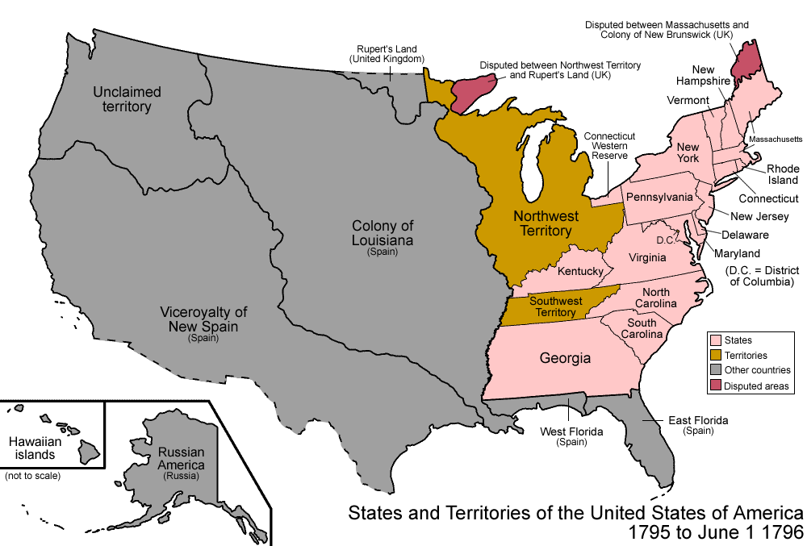
Treaty with Spain
Thomas Pinckney’s Treaty
Settled differences between the US and Spain.
It gave Americans free navigation of the Mississippi River and the right to trade at New Orleans.

Slide 20
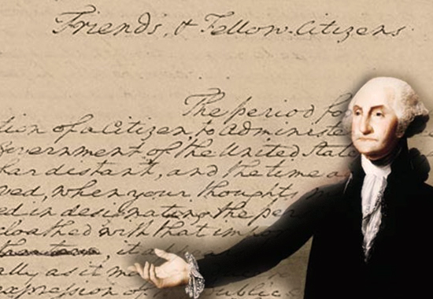
Washington’s Farewell
Washington decided not to seek a third term.
He didn’t like political parties’ or the nations involvement in foreign affairs and urged his fellow citizens to “steer clear of permanent alliances”.
These words influenced the nation’s foreign policy for more than 100 years.

Slide 21
III. The First Political Parties
Opposing Views
By 1796, Americans were beginning to divide into opposing groups and to form political parties.
At this time, many considered political parties to be harmful.
Political parties were not even mentioned in the Constitution.

Slide 22
Opposing views cont.
Washington disapproved of political parties and warned they would divide the nation.
Hamilton and Jefferson often had opposing views on topics.
Even Washington was partisan (favoring one side of an issue).
Washington usually supported Hamilton’s positions.

Slide 23
Political Parties Emerge
By the mid-1790s two distinct parties formed.
Federalists
The name Federalist changed to mean someone who supported the policies of the Washington administration. It stood for a strong federal government and favored banking and shipping interests.

Slide 24
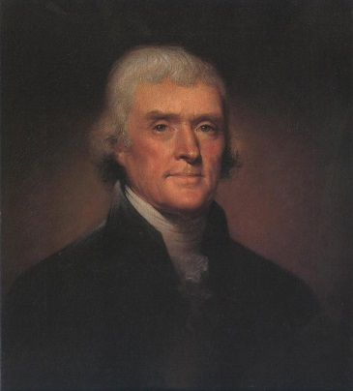
Political Parties Emerge Cont.
Democratic-Republicans (Future Democrats)
Called Republicans for short. Jefferson and Madison helped organize the party and write opinions against the Federalist policies.
They wanted to limit the government’s power.
Their policies appealed to small farmers and urban workers.

Slide 25
Election of 1796
First election with rival political parties.
To prepare, both parties, Federalists and Democratic-Republicans, held meetings called caucuses.
Each party chose their candidate at the caucuses.
The Federalists nominated John Adams.
Democratic-Republicans nominated Thomas Jefferson.

Slide 26
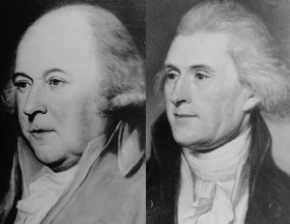
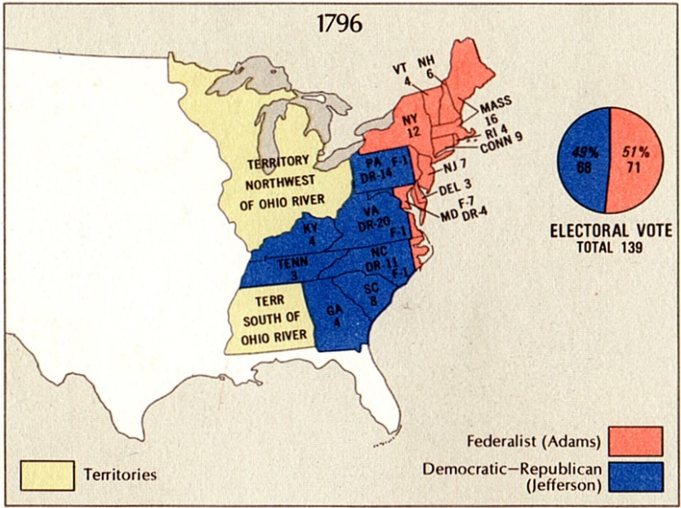
Election of 1796 Cont.
Adams and Jefferson, who used to be good friends, became bitter rivals.
Adams won the election with 71 electoral votes to Jefferson’s 68 votes.
At that time, the person with the second highest votes, became the vice president.

Slide 27
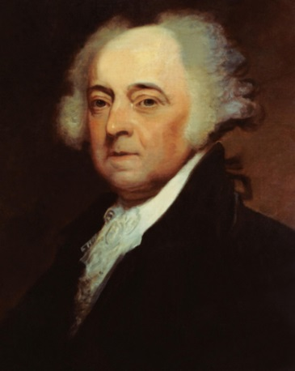
President John Adams
When he became president, he inherited the dispute with France.
Adams sent a team to Paris to try to resolve the dispute.
The French foreign minister, Talleyrand, refused to meet with the Americans.
Instead, he sent three agents who demanded a bribe and a loan for France from America.
The Americans refused and sent a report to Adams.
President Adams was furious and referred to the three agents as X, Y, and Z.
The Incident became known as the XYZ Affair.

Slide 28
Alien and Sedition Acts
As public anger rose against France, Americans became more suspicious of aliens (Immigrants/residents living in the country who were not citizens).
They passed strict laws to protect the nations security.
The laws were known as the Alien and Sedition Acts.
Sedition-Refers to activities aimed at weakening the established government.
The Alien Act-Allowed the President to imprison aliens or send those considered dangerous out of the country.

