Slide 1
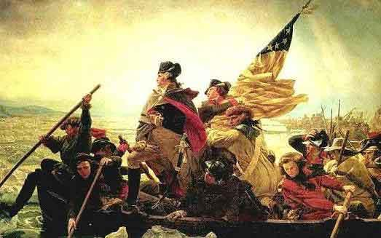
The Revolutionary War

Slide 2
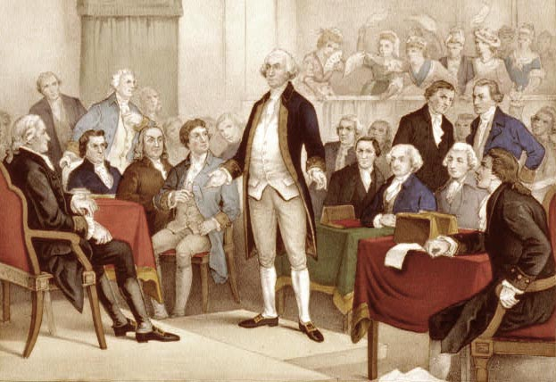
Part I: A Call To Arms
The Continental Congress
Where? Philadelphia When? September 1774
Who? 55 Delegates from 12/13 Colonies (Georgia not there)including George Washington, Patrick Henry, John Jay, Samuel Adams, John Adams, and Roger Sherman, Richard Henry Lee in attendance.
What? Drafted a statement of grievances in response to the Intolerable Acts
Agreed to Boycott British Goods

Slide 3
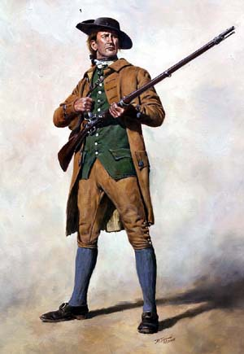
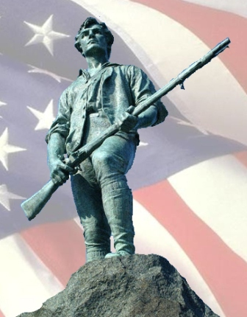
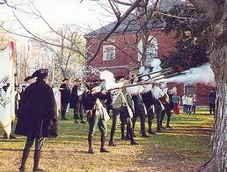
The First Battles: Minutemen
Militia-Citizens who trained and had drills with other citizen soldiers. Helped defend towns.
Minutemen-Militia from New England State who boasted they could be ready in a minutes notice.
Colonial militia who fought 1st battles.

Slide 4
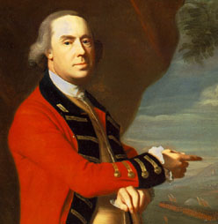
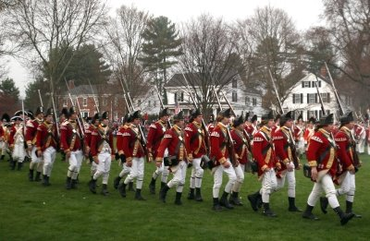
The British prepare for conflict
Lead by Thomas Gage-General/Governor of Mass.
Sent in more troops around the city of Boston, but by April 1775 several thousand were on their way.

Slide 5
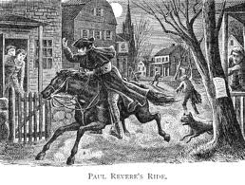
Paul Revere's Ride: April 18, 1775
William Dawes and Dr. Samuel Prescott joined
British heard of ammunition stored in Concord Mass. and planned to send troops to confiscate the stockpile.
Purpose was to get to Lexington and warn Sam Adams and John Hancock that the British were coming. Commercial
Warn Concord to hide weapons

Slide 6
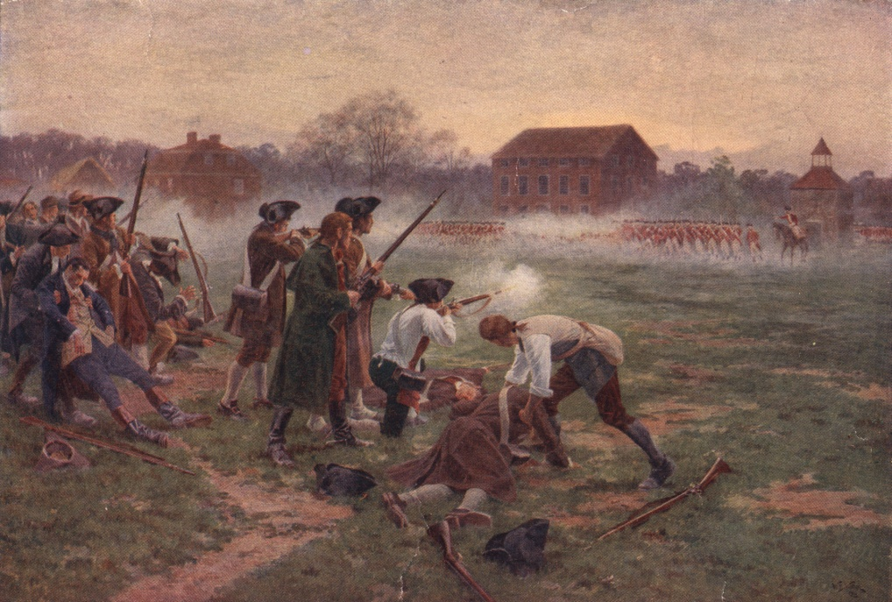
Lexington and Concord-April 19, 1775
First battles of the Revolutionary War
British open fire on 70 Minutemen on town common after a random shot fired. Killed 8 Minutemen.
Captain John Parker
“Stand your Ground.
Don’t fire unless fired
upon, but if they mean to
have war let it begin here.”
Battle Scene 1 #2

Slide 7
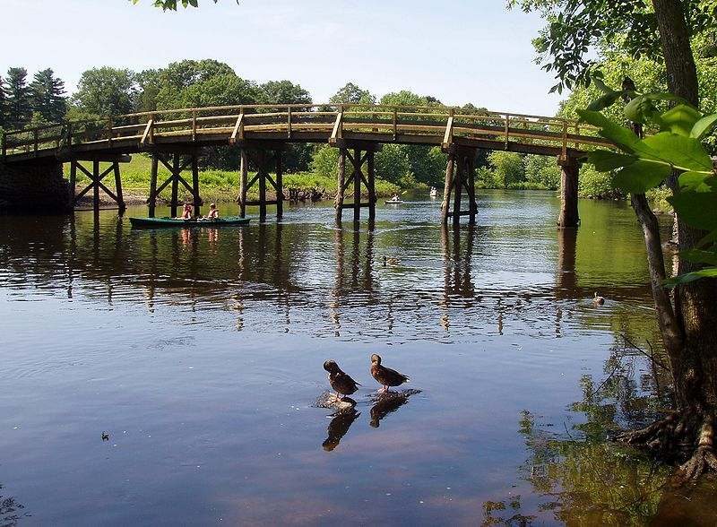
Concord Cont.
After British arrived in Concord:
-They burned supplies they could find.
-Rebels attacked them repeatedly on the way back to Boston. (174 wounded, 73 Dead British)
American victory, but lead to Boston Siege
"The Shot heard round the world", Ralph Waldo Emerson Concord Hymn

Slide 8
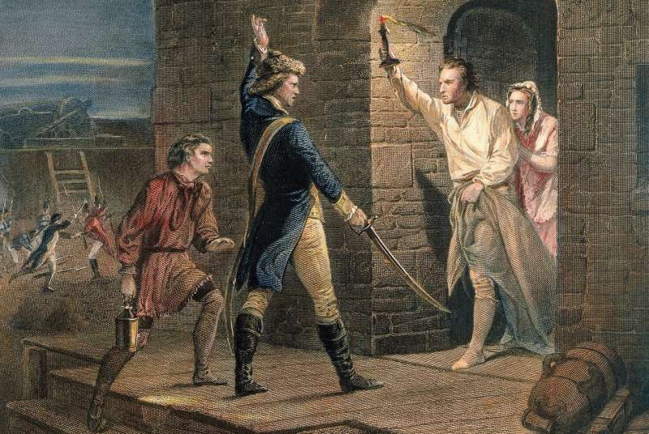
Fort Ticonderoga
Captain Benedict Arnold of Connecticut raised a force of 400 and planned to seize Fort Ticonderoga near Lake Champlain in New York.
He was joined by Ethan Allen and the Green Mountain Boys.
Together they took the British by surprise and took the fort on May 10, 1775.

Slide 9
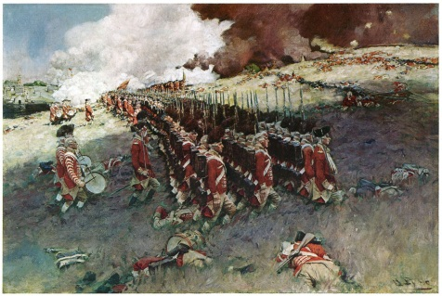
The Battle of Bunker Hill
On June 16, 1775, _20,000____ militiamen under the command of Colonel William Prescott, set up a defense posts on Bunker Hill and nearby Breeds Hill, across the harbor from Boston.
The battle started on Breeds Hill when British troops attacked with bayonets drawn.
-Prescott is famous for telling his troops, "Don't Fire until you see the white’s of their eyes.”
-The Americans had to withdraw when they Ran out of gunpowder.
The British had charged up the hill 3 times.
-Although the British won the battle they
found out that the Americans would not
be quick or easy to defeat . Video

Slide 10
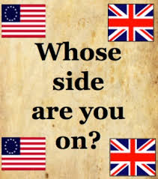
Which side to join?
Loyalists/Tories
Patriots/Rebels
Sided with Britain
Didn’t think taxes and unfair laws justified rebellion.
Weren’t suffering
Thought British would win
Officeholders who were responsible to British
Supporters of the war
Believed colonists had the right to govern themselves.
P. 127 ?’s

Slide 11
Part II: Moving Toward Independence
2nd Continental Congress (May 10, 1775)
-Delegates returning to the Second Continental Congress from the First Continental Congress
included John and Samuel Adams, Richard Henry Lee, Patrick Henry, and George Washington.
-New delegates included Benjamin Franklin, Thomas Jefferson, and John Hancock, who became President of the Congress.
1. The Congress created the Continental Army to fight against Britain, and chose George Washington to lead.

Slide 12
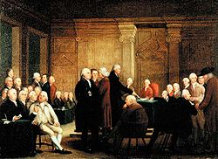
2nd Continental Congress Cont.
2. The Congress sent the _Olive Branch Petition to George III seeking peace and the protection of colonists' rights, but he rejected it.
-March 17 1776-Washington and his inexperienced army took back the city of Boston.
3. _Thomas Paine_ published Common Sense, which called for complete independence from Britain.

Slide 13
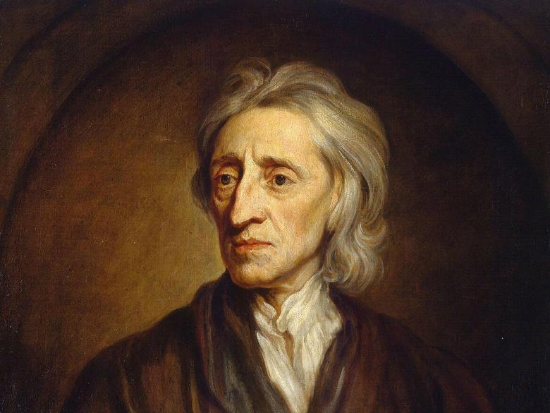
4. The Declaration of Independence
A. The resolution for independence was proposed by Richard Henry Lee.
B. The Declaration of Independence was written by Thomas Jefferson.
C. Jefferson borrowed ideas from English philosopher John Locke. This included the idea of people being born with Natural rights to Live, Liberty and Property.

Slide 14

Declaration Continued
D. Congress approved the Declaration of Independence on _July 4, 1776.
E. Hancock signed the document first and made sure to write large enough so that King George III could read it without his glasses.
E. The Declaration includes:
-The introduction or Preamble
-List of rights the colonists should have
-Colonists’ complaints against Great Britain
-Declares the existence of the new nation.

Slide 15
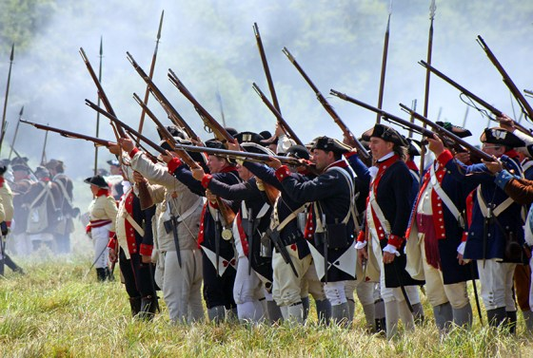
Continental Army Faces Early Trouble
Each colony supported their own army-13 Separate wars.
Soldiers signed up for only 1 year typically.
Not many officers

Slide 16
Battle of Long Island
August 27, 1776
Continental Army defeated
Nathan Hale, “I only regret that I have but one life to lose for my country.” -Caught as a spy
Americans ran short on basic supplies (shoes, jackets)
British took control of New York City

Slide 17
Battle of Trenton
Christmas Night 1776
Low point of the war as troops terms up and had lost almost every battle.
Washington and 2, 400 troops crossed the Delaware River and surprised the British and Hessians in Trenton the next day.
Washington evaded British reinforcements and drove them out of Princeton where they had planned to spend the winter.
New life breathed into the cause. Crossing Video.

Slide 18
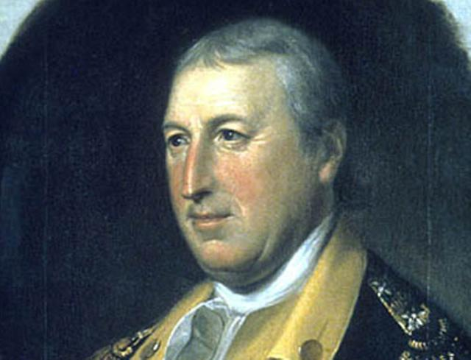
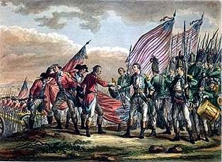
Battle of Saratoga
General Burgoyne was defeated by American General Horatio Gates. Oct. 1777. (Turning Point of the War because French decide to help)
British had planned to separate New England from the Middle colonies by taking Albany NY.
-However, British moved too slowly out of Canada to meet in New York with General Howe’s men

Slide 19
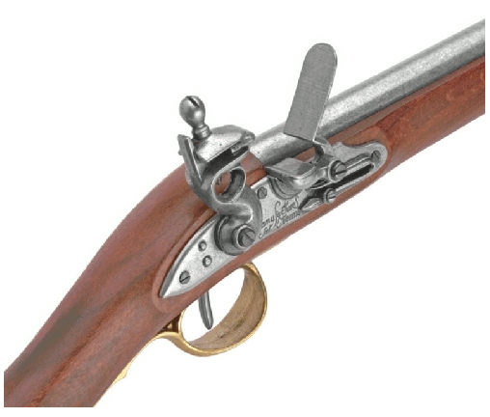
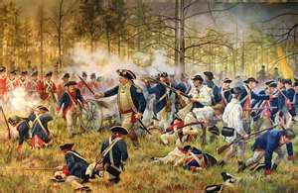
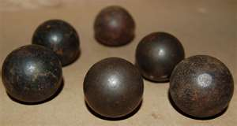
Battles Tactics and Strategy
British: Gentlemen’s Warfare
-Quarter given to surrendering troops, no targeting civilians, no shooting of officers, each side lines up and exchanges volleys until one side breaks.
Muskets were used by most troops, not very accurate and most battles involved bayonet charges. Video

Slide 20
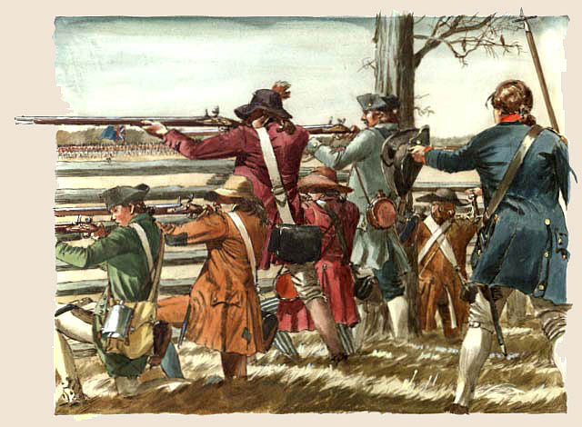
American Tactics
Began the war using Gentleman’s warfare.
Throughout the war adjusted to use more guerrilla warfare tactics. -Hit and run tactics using militia.
Video
Goal became to simply
keep army alive long
enough to wear out the
British.

Slide 21

Advantages for the British and Americans
British Advantages
-Strong Army/Navy
-Experience
-A lot of weapons and Ammunition
-Richest country in the world
-American’s Divided
Loyalist/Patriot
Patriot (American) Advantages
-At home
-Determined
-British used mercenaries
-Cause: Freedom
-Leadership: Washington

Slide 22
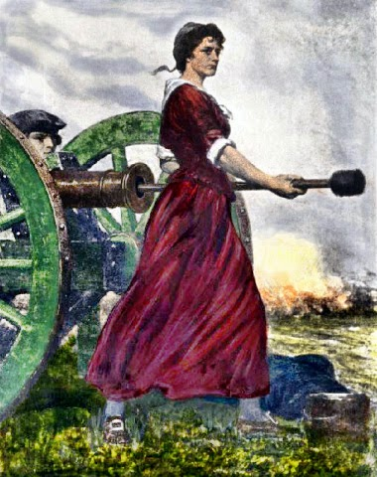
Women in the War
Margaret Corbin-Took husbands place in battle after he died.
Mary Ludwig Hays McCauley “Molly Pitcher”-Joined her husband in battle and brought pitchers of water to troops.
Deborah Sampson-Disguised herself as a man and joined the war.

Slide 23
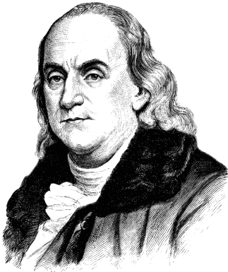
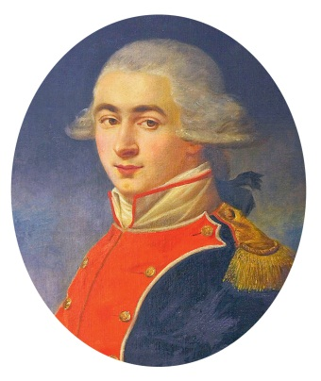
Gaining Allies
France
-Victory at Saratoga was a major turning point because other nations, especially France, realized that the Americans might have a chance to win the war.
-In 1777, America had sent Benjamin Franklin to France to gain support.
-February, 1778 the French announced their support and declared war on Great Britain. They also sent money, supplies and troops to aid America.
-Marquis de Lafayette- a French nobleman, offered his Services to General Washington and became a trusted aide.

Slide 24
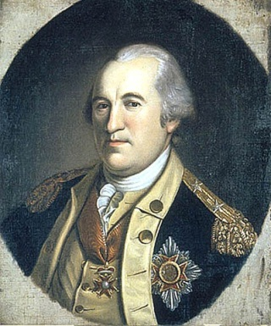
Others
Poland sent Thaddeus Kosciuszko and Casimir Pulaski to help build effective defenses for the Americans.
-(Baron) Friedrich von Steuben from Prussia also came to Washington. He helped train the Patriot troops at Valley Forge. He turned the Continental Army into a more effective fighting force.

Slide 25
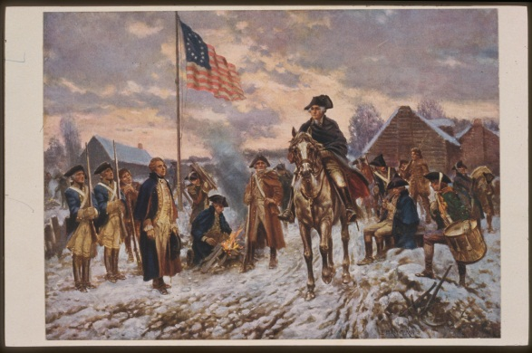
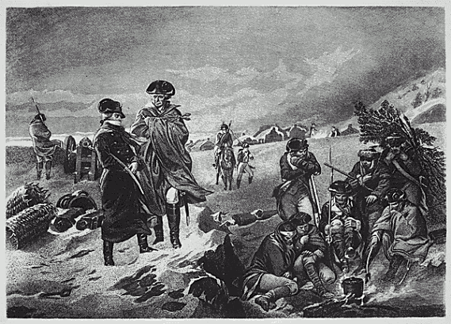
Winter at Valley Forge 1777-1778
-British forces under General Howe spent the winter in Philadelphia.
-Washington’s men set up at Valley Forge and endured a long, cold winter.
-They lacked decent food, clothing, shelter and medicine.
-Some troops deserted- left without permission and some officers resigned.
-In April 1778 they discovered that the French had joined their cause, which further lifted their spirits.

Slide 26
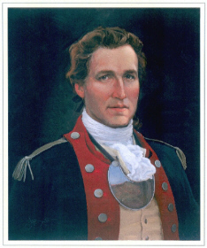
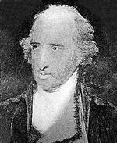
War in the West
-Some Native Americans helped the Patriots, but more sided with the British because they seemed like less of a threat.
-West of the Appalachian mountains, the British under the leadership of Henry Hamilton, who was stationed in Detroit, and their Native American allies lead by Joseph Brant raided American settlements.
-Hamilton was nicknamed “Hair Buyer”, because he paid Native Americans for settlers’ scalps.
-George Rogers Clarke, a lieutenant colonel in the Virginia militia wanted to help put an end to this activity.
-He took forts from the British in present day Illinois and Indiana. His biggest victory was taking back Vincennes in Feb. 1779.

Slide 27
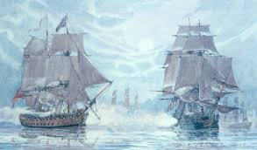
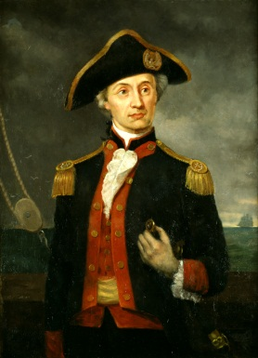
War at Sea
-Great Britain had a very powerful Navy and formed an effective blockade. This stopped supplies from getting to the Continental Army.
-The Continental Congress ordered ships to be constructed, but the British quickly captured all but 2 of the ships.
-Congress than authorized _2000 ships to sail as privateers-privately owned merchant ships with weapons. These ships were much more successful in capturing more British ships than the actual navy.
-One American Naval officer John Paul Jones was made famous for attacking British Ports. On Sept. 1779 Jones ship Bonhomme Richard battled the British warship Serapis for hours. When asked if he would surrender he stated, “I have not yet begun to fight.” In the end he won the battle and became an American navel hero.

Slide 28
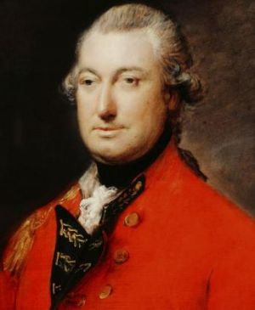
War in the South
-The British concentrated their efforts in the South because there were many more Loyalists.
-The British Army under Henry Clinton took the city of Savannah, Georgia, and Charles Town, South Carolina by 1780, and took thousands of prisoners.
-General Cornwallis oversaw all British forces in the South. He won the battle of Camden but began to struggle against new tactics.

Slide 29
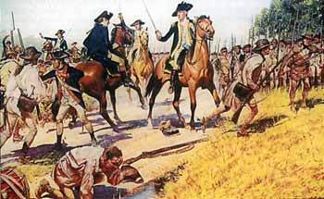
War in the South Cont.
-Francis Marion AKA the “Swamp Fox” utilized Hit and run techniques to keep the British off guard (Guerilla Warfare).
These tactics and lack of support from the Loyalists convinced Cornwallis it would be difficult to control the South.

Slide 30
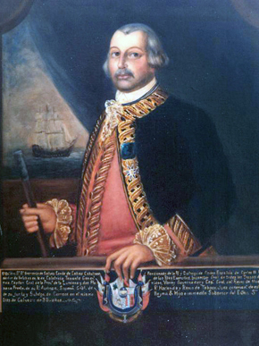

Spain Joins
Although Spain doesn’t recognize the US after the war, they still declared war against the British in 1779.
Louisiana Governor Bernardo de Galvez raised an army to help in the Louisiana Territory.

Slide 31
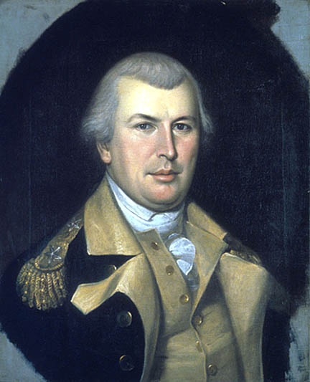
War in the South Cont.
A Major loss by the British at King’s Mountain to a group of militia increased the push for independence in the South.
Nathanial Greene replaced Gates in the south as leader of the Continental Army. He won the battle of Cowpens and fought effectively at Guilford Courthouse in 1781.
-Cornwallis was forced to retreat North into Virginia.

Slide 32
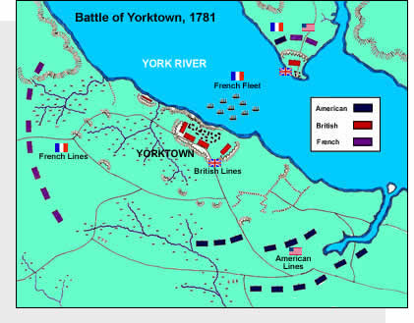
Battle of Yorktown Sept. 28-Oct. 19 1781
Washington’s 4 part plan for victory
He had already sent Lafayette and Anthony Wayne to Virginia to fight Cornwallis.
A French fleet was on its way to the Chesapeake where Cornwallis was camped at Yorktown.
He tricked General Clinton into thinking he was going to attack New York. That kept Clinton out of the battle in the South.
Washington and French General Rochambeau rushed South. They marched 200 miles in 15 days.
*July 1780: Benedict Arnold switched to the British side.

Slide 33
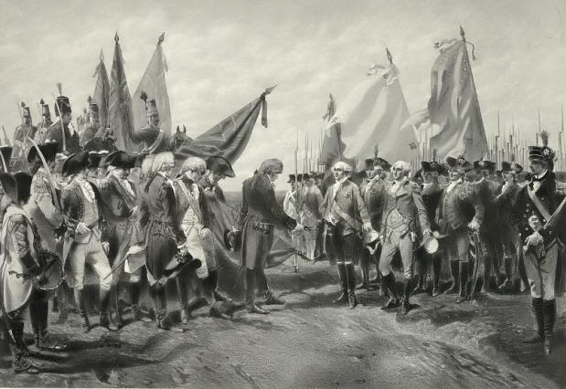
Battle of Yorktown-What Happened?
-14,000 American and French troops met 8,000 British in Yorktown.
-The French fleet blocked the Chesapeake from British reinforcements.
The siege lasted about a month.
About 8,000 British troops surrendered as a French band played “Yankee Doodle”.
This battle basically brought an end to the war.

Slide 34
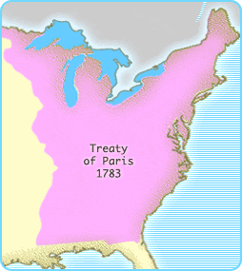
Treaty of Paris
American Delegates: Ben Franklin, John Adams, and John Jay
When: Ratified (approved) in April 1783 and officially signed on Sept. 3, 1783.
Americans Received:
Britain agreed to Remove all troops from American Soil and allowed Americans to Fish off the coast of Canada.
British Received:
Americans: Loyalists were given back their Land and America had to pay back British Merchants.

Slide 35
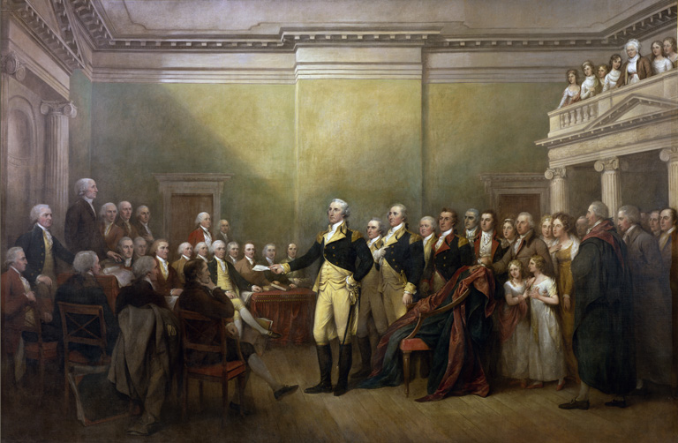
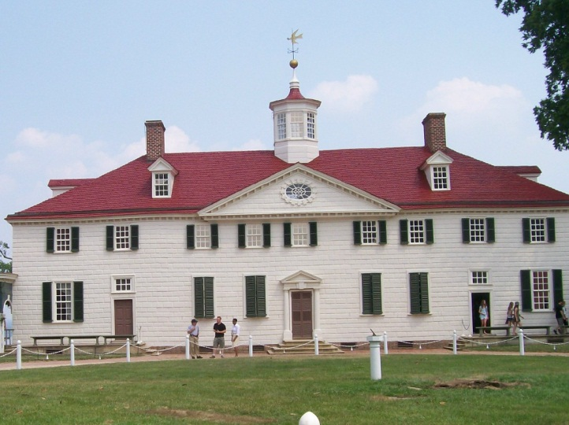
After the War
By November 1783 the last British troops finally left New York.
On Dec. 4, 1783, Washington said farewell to his army and resigned in a meeting with Congress.
He planned to return home to Mount Vernon, Virginia and live quietly with his family.

Slide 36
Final Numbers
*50,000 Americans killed or wounded
*40,000 British Army and Navy killed or wounded
*7,500 Germans killed or wounded
Now left to fend for ourselves and create a new government☺

