Slide 1
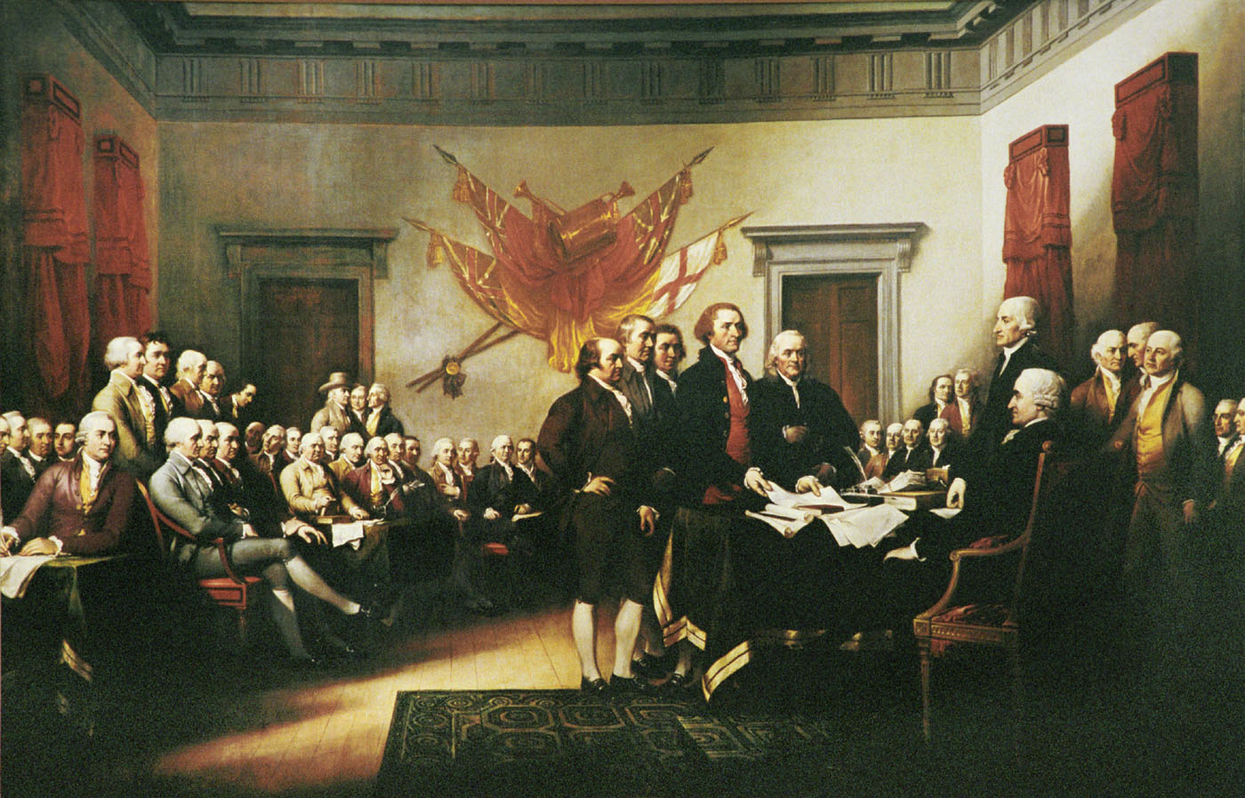
Unit 2: Causes of the Revolutionary War

Slide 2
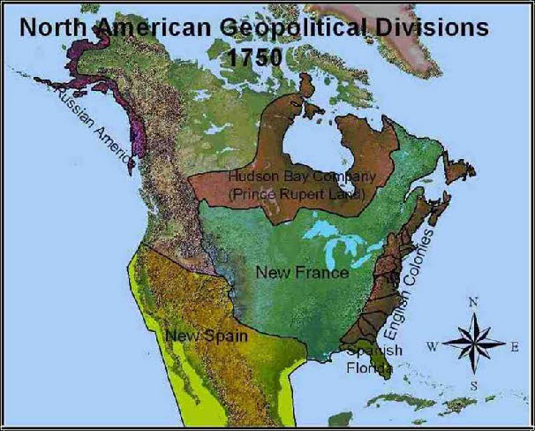

Slide 3
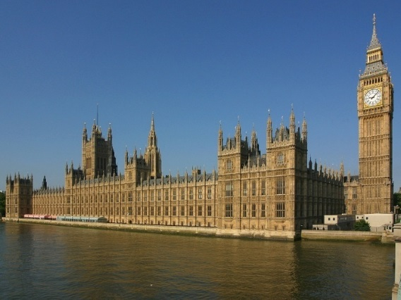
Cause #1: English Colonial Rule
*The Navigation Acts 1651-1673
England like many other European nations started to follow the theory of Mercantilism.
This meant that they were trying to build wealth by exporting more than they were importing.

Slide 4
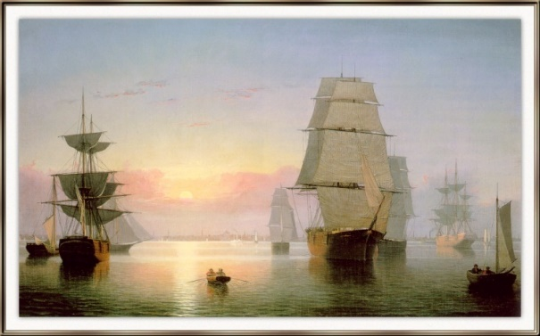
Navigation Acts Cont.
Making $: Raw materials from colonies and colonists had to buy English manufactured goods.
Describe: Couldn’t use foreign ships even if rates were cheaper. Could only send products to places in England’s Empire.
Reaction: Colonists didn’t mind at first, but started to resent the restrictions. Some ignored the laws and started smuggling or trading illegally.

Slide 5
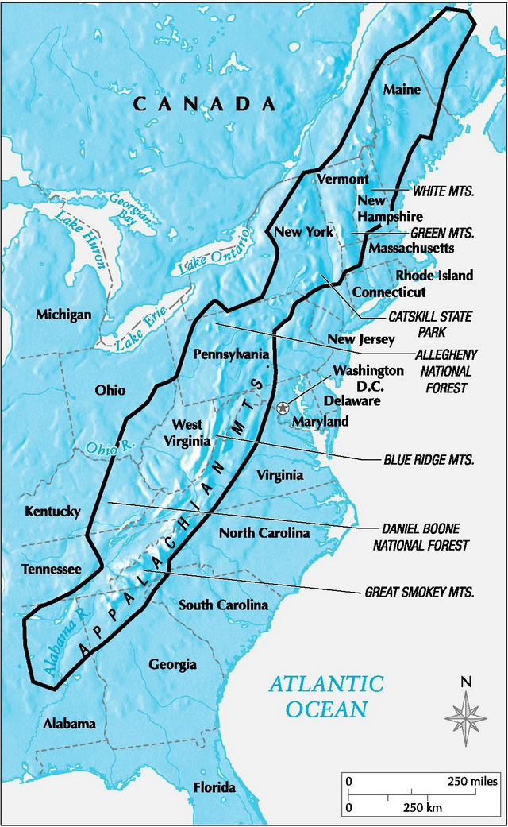
Cause #2: The French and Indian War.
Both wanted control of the Ohio River Valley, the lands west of the Appalachian Mountains.
Both sides began building forts in the Ohio River Valley. Because the French controlled the land they attacked and took a British fort and renamed it Fort Duquesne.

Slide 6
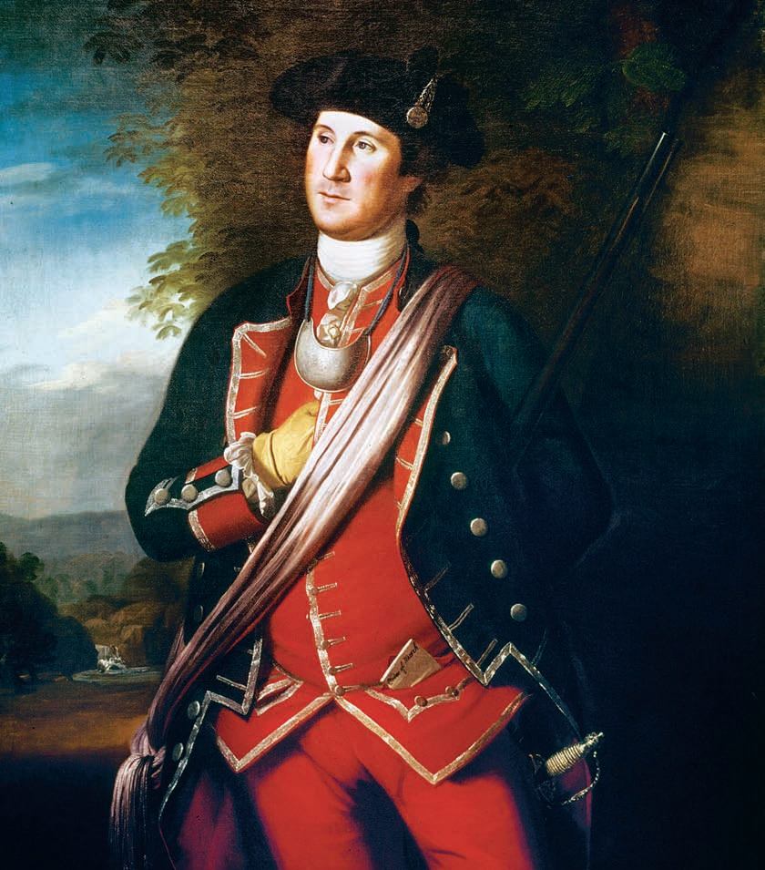
British and French Rivalry Cont.
George Washington tried to take Duquesne back.
Under his command they built Fort Necessity.
Fort Necessity also taken by the French.
Beginning of George Washington’s military career.

Slide 7
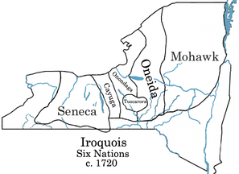
*Iroquois Confederacy
The French had more NA allies because of their Fur Trade.
Most powerful group of Native Americans in the Northeast. Also, known as the 6 Nations
The Iroquois Confederacy agreed to remain neutral between the French and British.

Slide 8
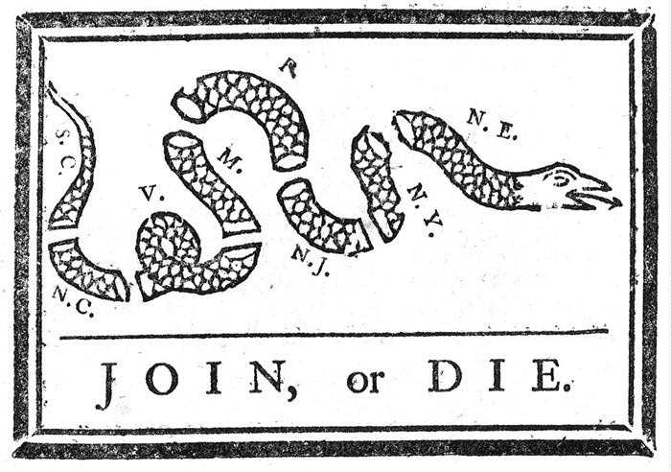
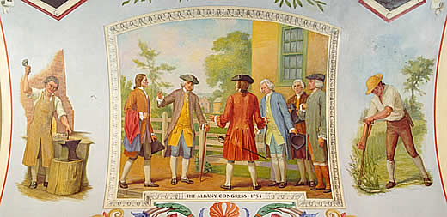
The Albany Plan
Plan made up by Benjamin Franklin
Called for a united Colonial Government.
Failed: None of the colonies approved the plan. They were afraid to give up their own power. Didn’t unite the colonists against the French.
Literary analysis questions?

Slide 9
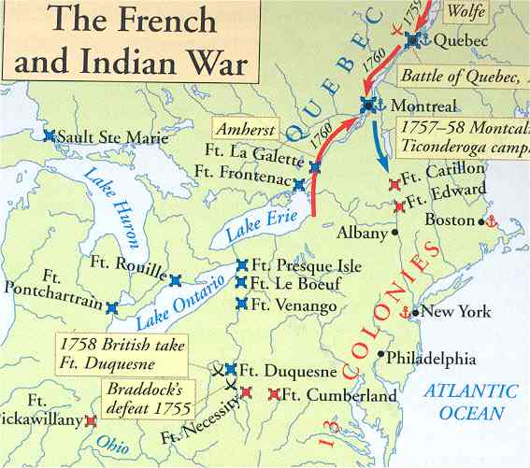
*The French and Indian War Breaks Out.
The French enjoyed early success in the war fighting against mostly colonists west of the App. Mtns. And benefitting from the aid of Native American allies.

Slide 10
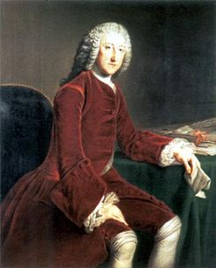
French and Indian War Cont.
William Pitt-Military planner was sent over from England. He decided Britain would pay for the war and ran up tremendous debt.
War ended when the British took the cities of Montreal and Quebec in Canada.

Slide 11
*The Treaty of Paris 1763
France had to give Great Britain Canada and most of its lands east of the Mississippi River. Spain received Louisiana and the port of New Orleans.
The treaty marked the end of France as a power in North America and divided the continent between Britain and Spain.

Slide 12
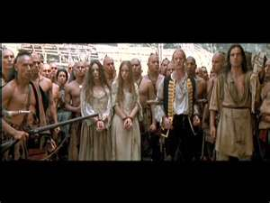
Cause #3: The Proclamation of 1763
French loss dealt blow to Native Americans in the Ohio River Valley.
They had lost their allies and trading partners. Britain raised the price of their goods. More British settlers were moving onto Native American lands.

Slide 13
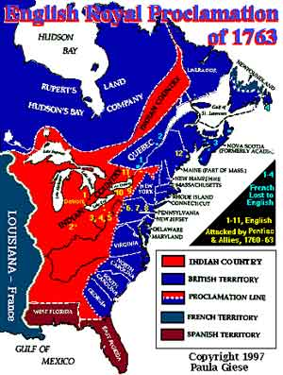
3. Proclamation Continued
Pontiacs War: War between Pontiac (Ottawa Chief) and British Forts west of App. Mtns. and settlers.
The Proclamation of 1763 stopped colonists from moving west of the Appalachian Mountains.
Advantages for Britain:
-Kept peace with Native Am’s
-Kept colonists near the coast to keep trade flourishing.
-Could keep control of westward expansion and the fur trade in the frontier.
*Colonists resent troops and control of land by British.

Slide 14
Cause #4: Taxation without Representation
Britain had huge debt from the French and Indian War. They issued taxes on colonies and enforced existing tax laws more strictly to pay off their debt.
Writs of Assistance-Legal documents that allowed customs officers to enter any location to search for smuggled goods.

Slide 15
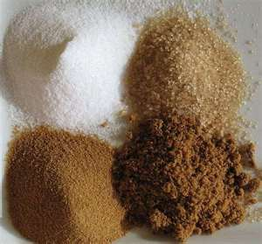
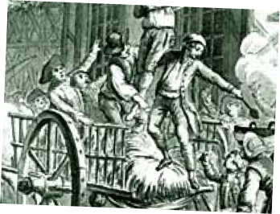
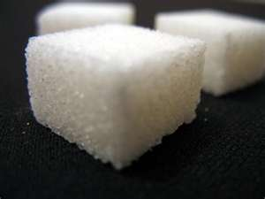
*The Sugar Act
Parliament passed in 1764. It lowered the tax on imported molasses.
It was an attempt to control smuggling.
It angered the colonists because it took away the right to a jury trial in smuggling cases.

Slide 16
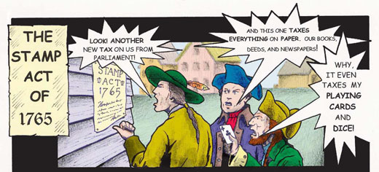
*The Stamp Act
This was a tax on almost all printed material. It even included newspapers, wills and playing cards.
Opposition:
-Colonists that only their own assemblies should lay taxes on them.

Slide 17
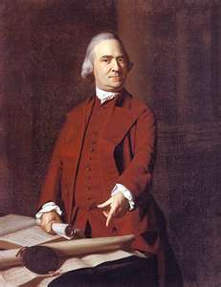
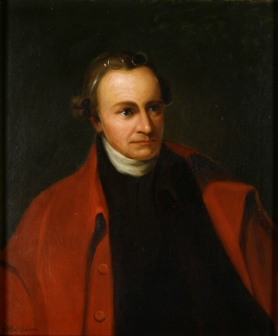
Stamp Act Opposition Cont.
Patrick Henry
Samuel Adams
Persuaded the Virginia House of Burgesses to pass a resolution (a formal expression of opinion) declaring on the colonies could tax their citizens.
Quotes: “I’m not a Virginian, I’m an American”
“…Give me liberty or Give me death!”
Started an organization in Boston called, “The Sons of Liberty”.
They led protests against the Stamp Act.

Slide 18
StampAct Opposition Cont.
Other groups throughout the colonies protested by burning effigies (rag figures) representing tax collectors.
Stamp Act Congress: 9 colonies met and drafted a petition to the king and Parliament.
Colonists urged merchants to boycott (refuse to buy) British goods.

Slide 19
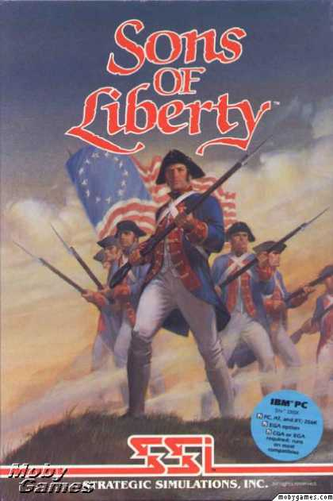
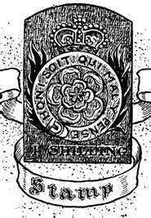
Stamp Act Cont.
Parliament eventually repealed (cancelled) the Stamp Act.
It was replaced with the Declaratory Act: stated that Parliament had the right to tax and make decisions for the British colonies “in all cases.”

Slide 20
*The Townshend Acts
They were a set of taxes that applied to imported goods such as glass, tea, and paper. The tax was paid when the goods arrived or the port of entry.
Opposition:
-Felt only representatives to Parliament should impose taxes on colonists.
-Women organized groups called Daughters of Liberty.
-They urged Americans to wear homemade fabrics and produce other goods they needed and not buy British goods.

Slide 21
Cause #5: The Boston Massacre-March 5, 1770
Trouble began in Boston in 1768
Great Britain sent “Redcoats” after hearing colonists on the brink of rebellion. Set up camps in the center of the city.
Mob instigated a violent encounter with British troops.
How many colonists were killed? 5
Crispus Attucks-a dock worker was one of the colonists killed. (1st casualty of the war)

Slide 22
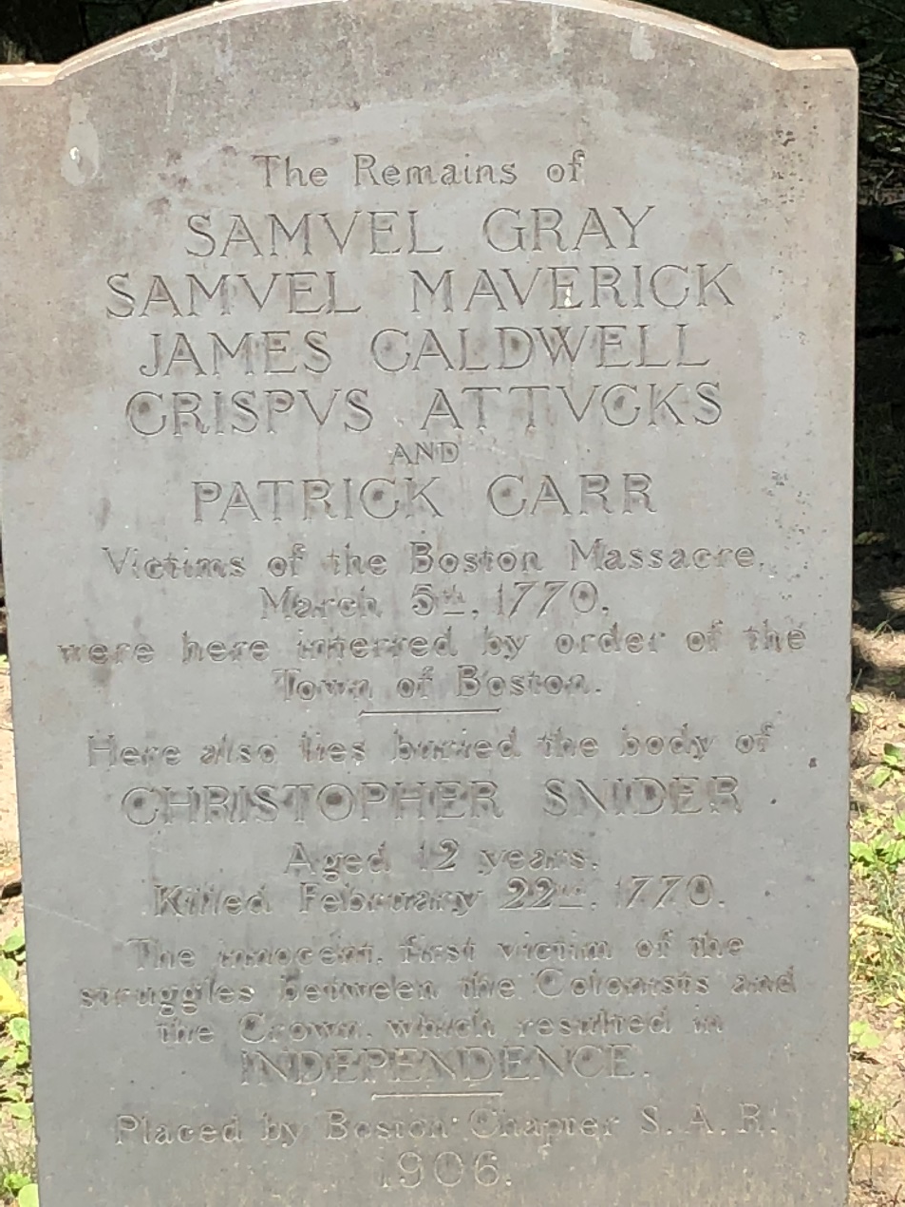
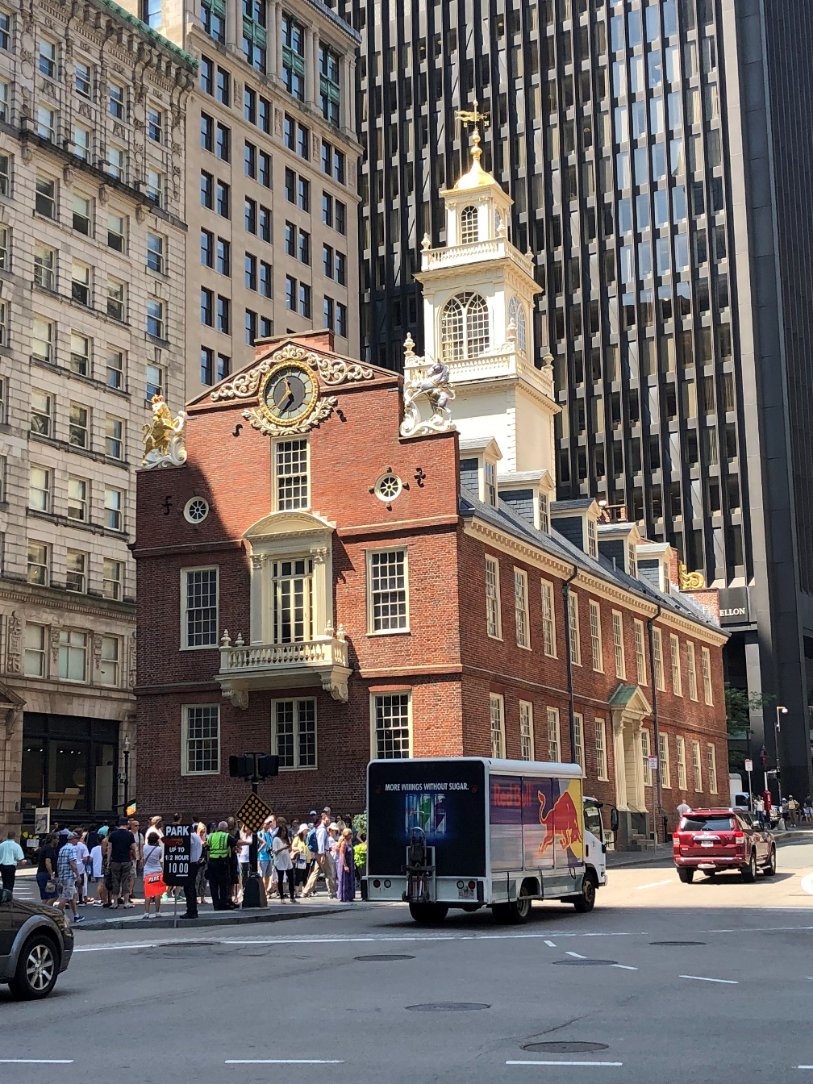
Pictures

Slide 23
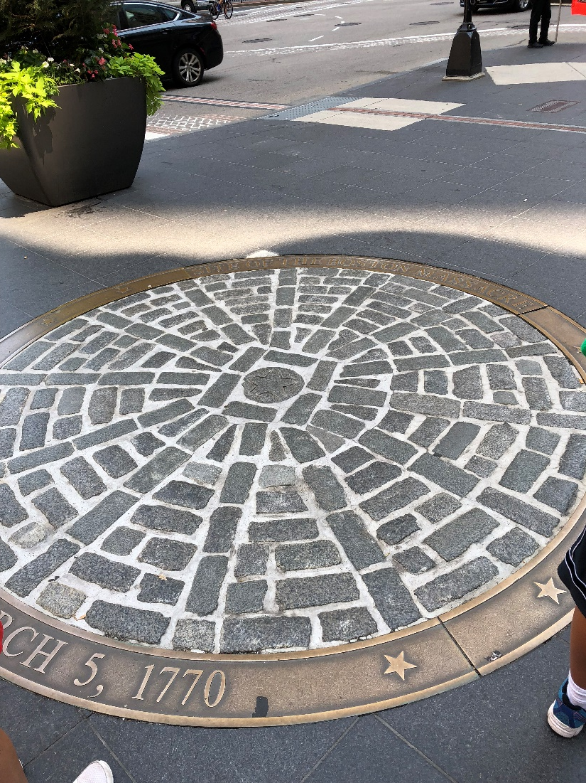
Pictures

Slide 24
Boston Massacre Continued
Colonial leaders used the killings as propaganda (information made to influence public opinion).
Samuel Adams put up posters calling the incident the Boston Massacre.
Paul Revere made an engraving showing the British troops firing on an orderly crowd.
This led colonists to call for stronger boycotts of British goods.
Eventually Townshend Acts repealed except Tea.

Slide 25
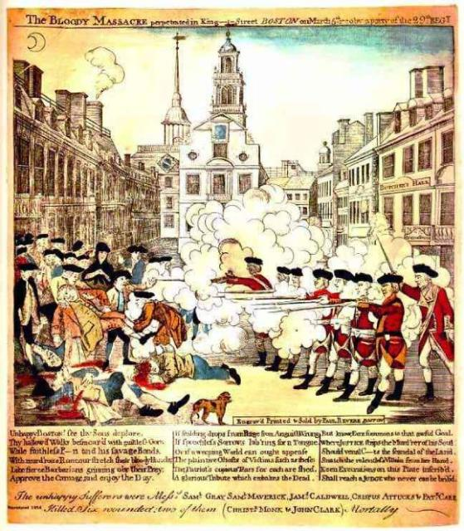

Slide 26
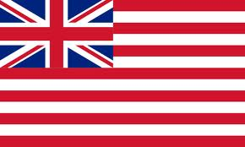
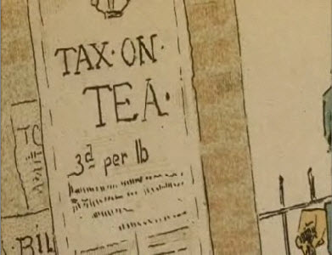
Cause #6: The Tea Crisis
*Tea Act: Passed by Parliament in 1773 because the British East India Company was facing ruin.
It allowed total control of the tea trade in America.
Why mad still? Wanted to choose tea and there was still a tax!
American merchants called for another boycott.

Slide 27
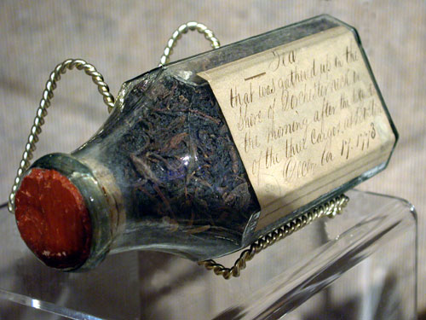
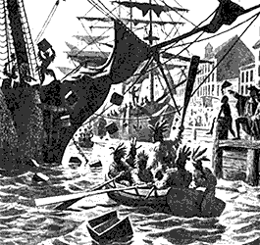
*Boston Tea Party
The Sons of Liberty organized a group, December 16, 1773.
They dressed like Mohawk Indians and threw 342 chests of Tea into Boston Harbor.
Tea Party Commercial 1, 2

Slide 28
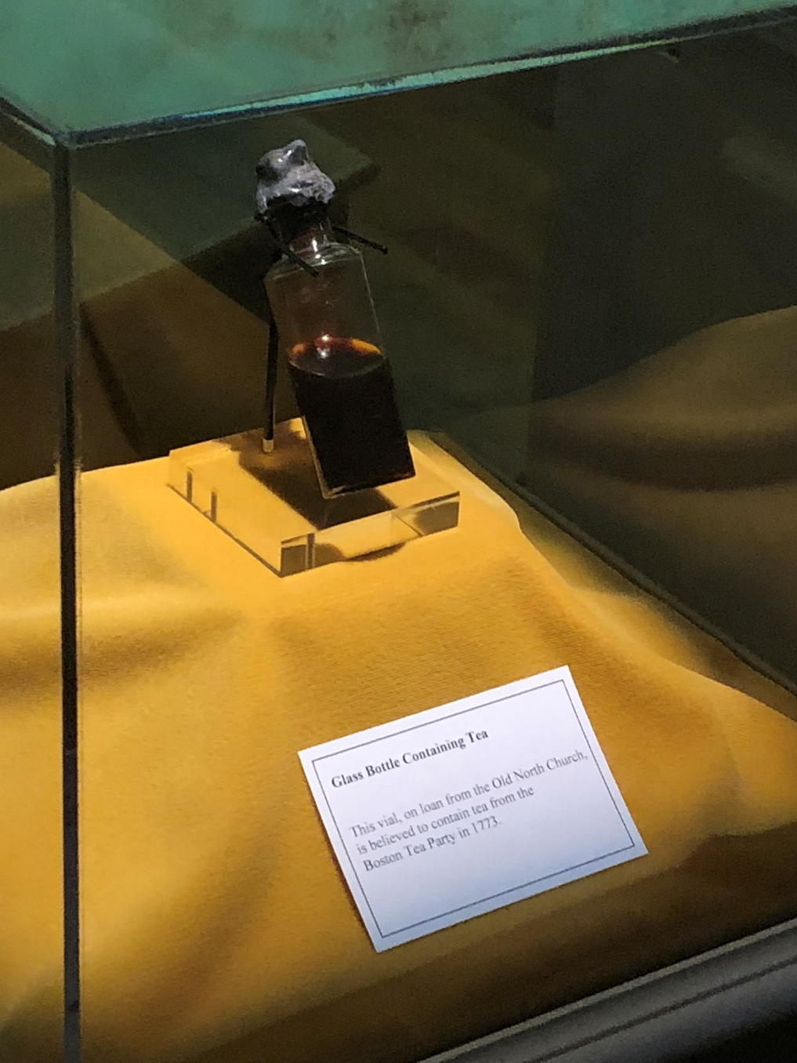
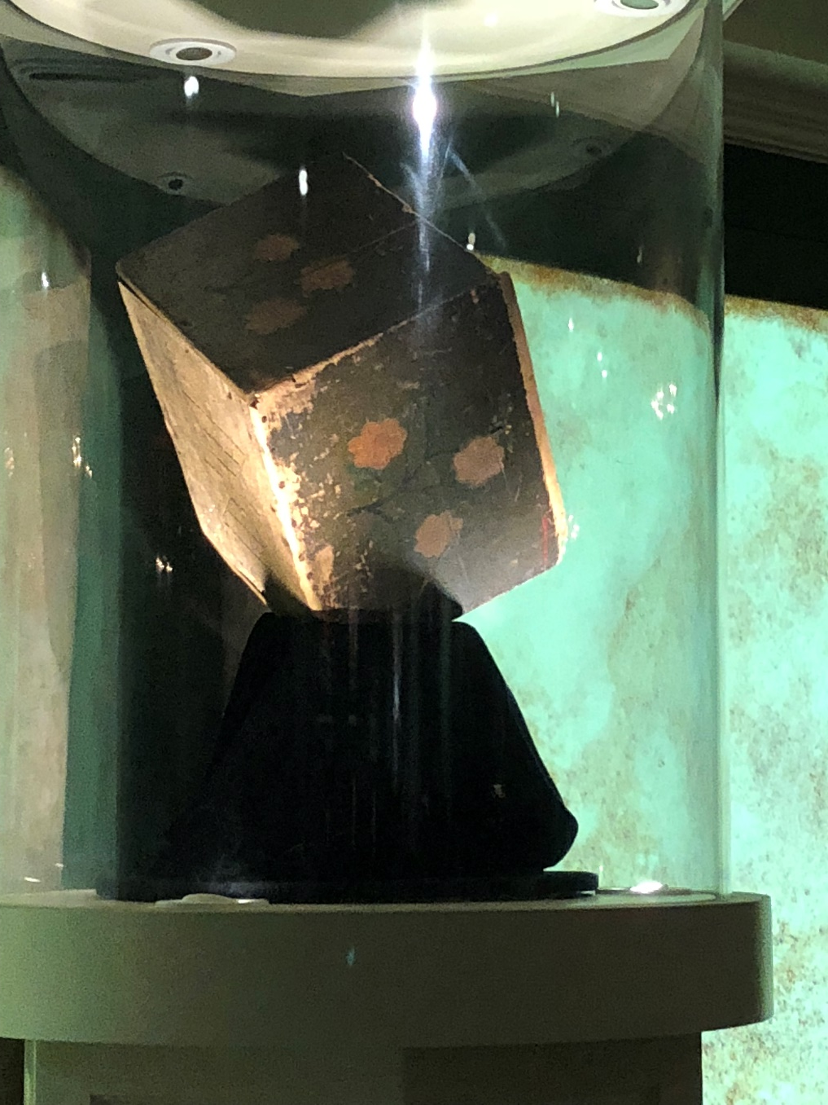
Boston Tea Party Pictures

Slide 29
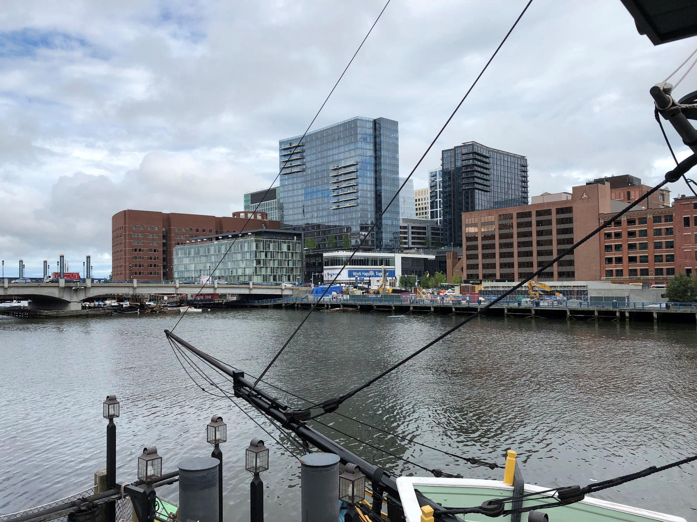
Boston Tea Party Pictures

Slide 30
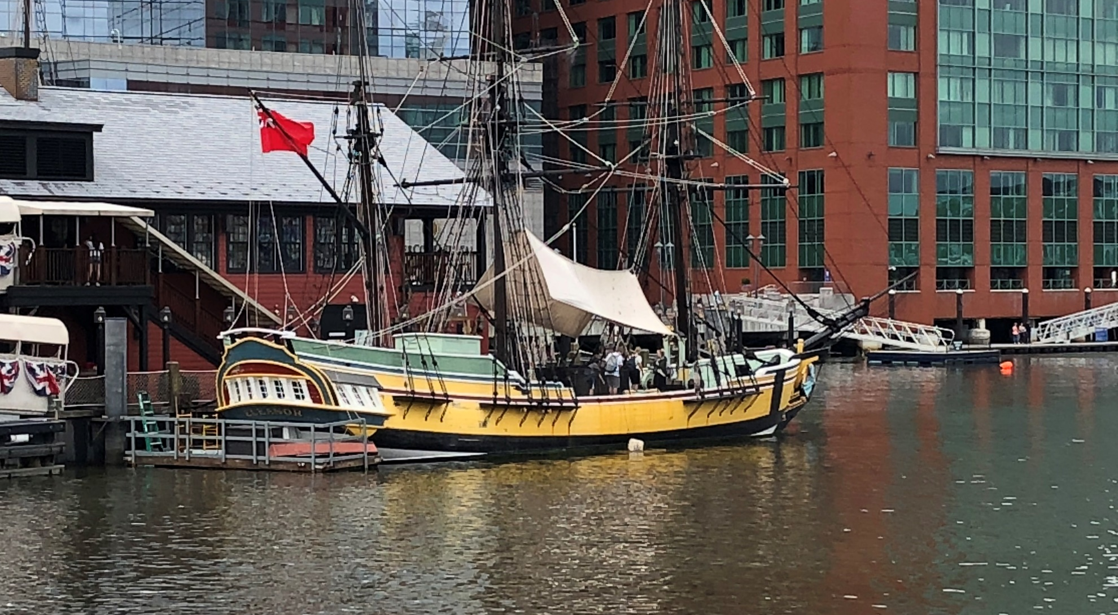
Boston Tea Party Pictures

Slide 31
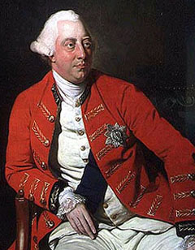
*Intolerable Acts (Coercive Acts)
King George III realized England was
losing control of the colonies.
-Act was designed to punish the colonists.
-Forced Bostonians to house British soldiers in colonists’ homes. (Quartering Act)
-Town meetings were banned.
-Closed Boston Harbor until the ruined tea was paid for.
-Food and supplies couldn’t get in.
-Colonists called the Coercive Acts the Intolerable Acts because they were painful and unbearable.

