Slide 1
Unit 11: The Civil War
1861-1865

Slide 2
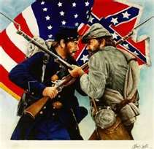
I. Introduction
South Carolina became the 1st state to secede on Dec. 20, 1860.
By February 1861, the following had also seceded:
1. Texas, 2. Louisiana, 3. Mississippi, 4. Alabama, 5. Florida, 6. Georgia

Slide 3
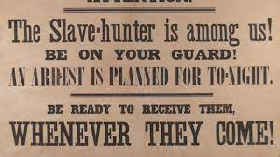
Why did Southern States feel they had a right to secede?
They believed that the States had voluntarily chosen to enter the Union and could leave because the National Government had broken the contract by not enforcing the Fugitive Slave Act and denying S. states equal rights in new territories.

Slide 4
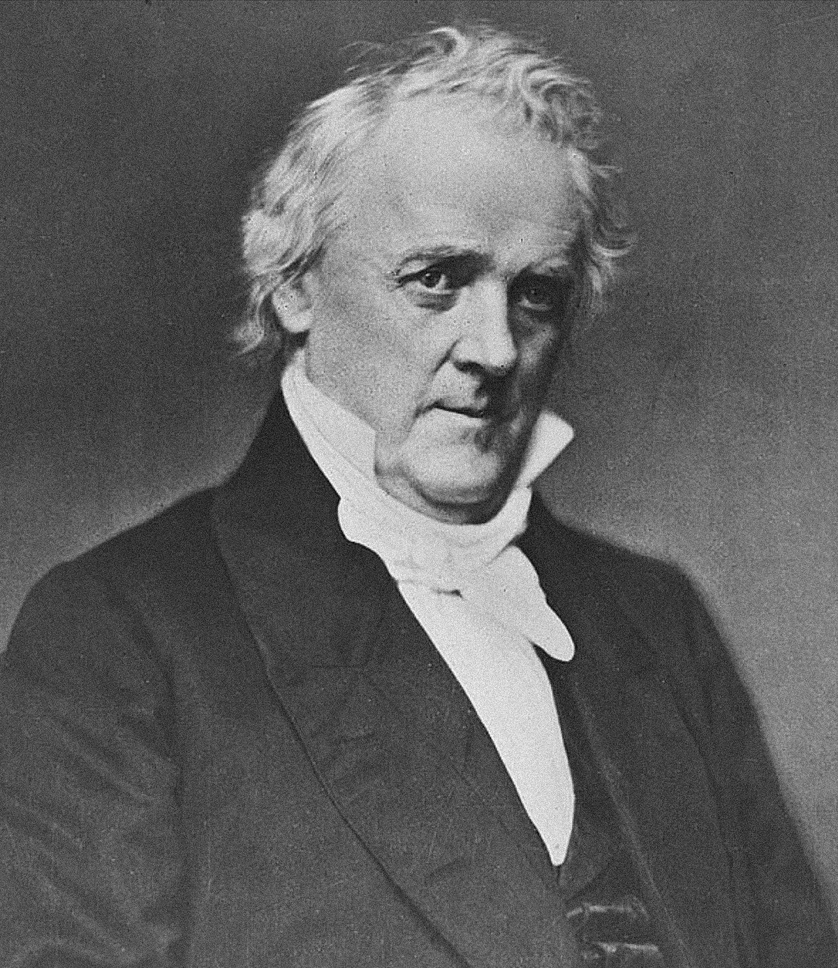
What did President Buchanan do?
He said the Southern States had no right to secede, but he had no power to stop them, so he did nothing.
After 1st shots fired at Ft. Sumter, Lincoln called for volunteers. The following states seceded at that point:
Virginia
North Carolina
Tennessee
Arkansas

Slide 5
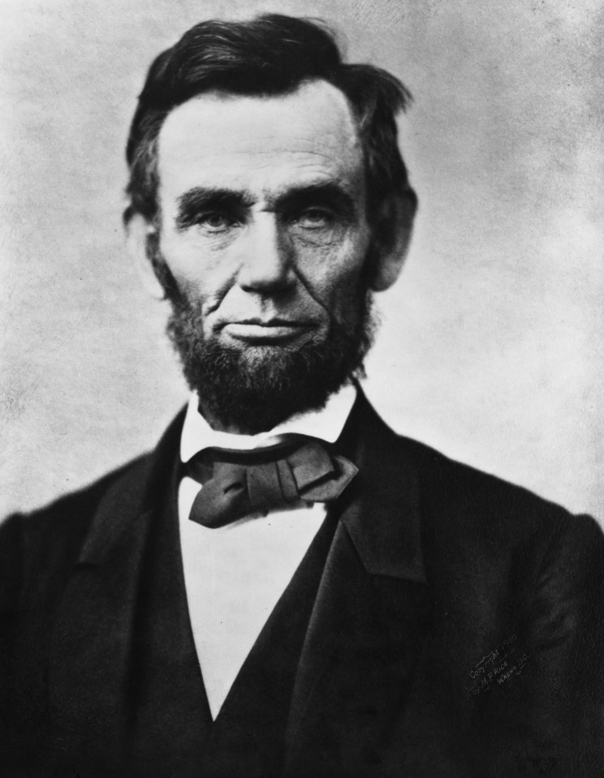
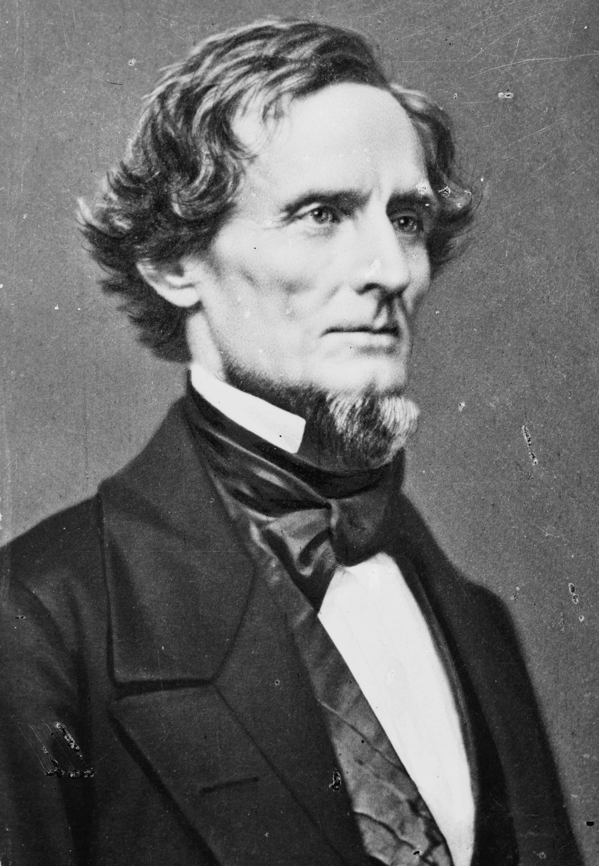
Union vs Confederacy
South
The Confederate States of America
11 Total States
President: Jefferson Davis
Capital: Richmond Virginia
North
The Union
24 Total States
President: Abraham Lincoln
Capital: Washington DC

Slide 6
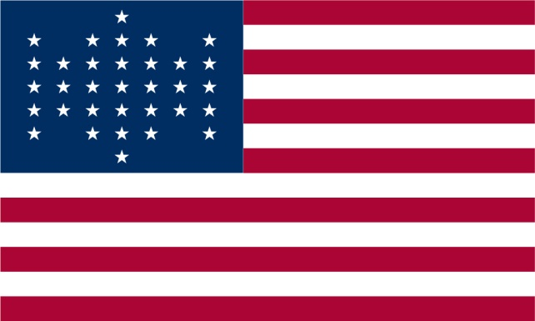
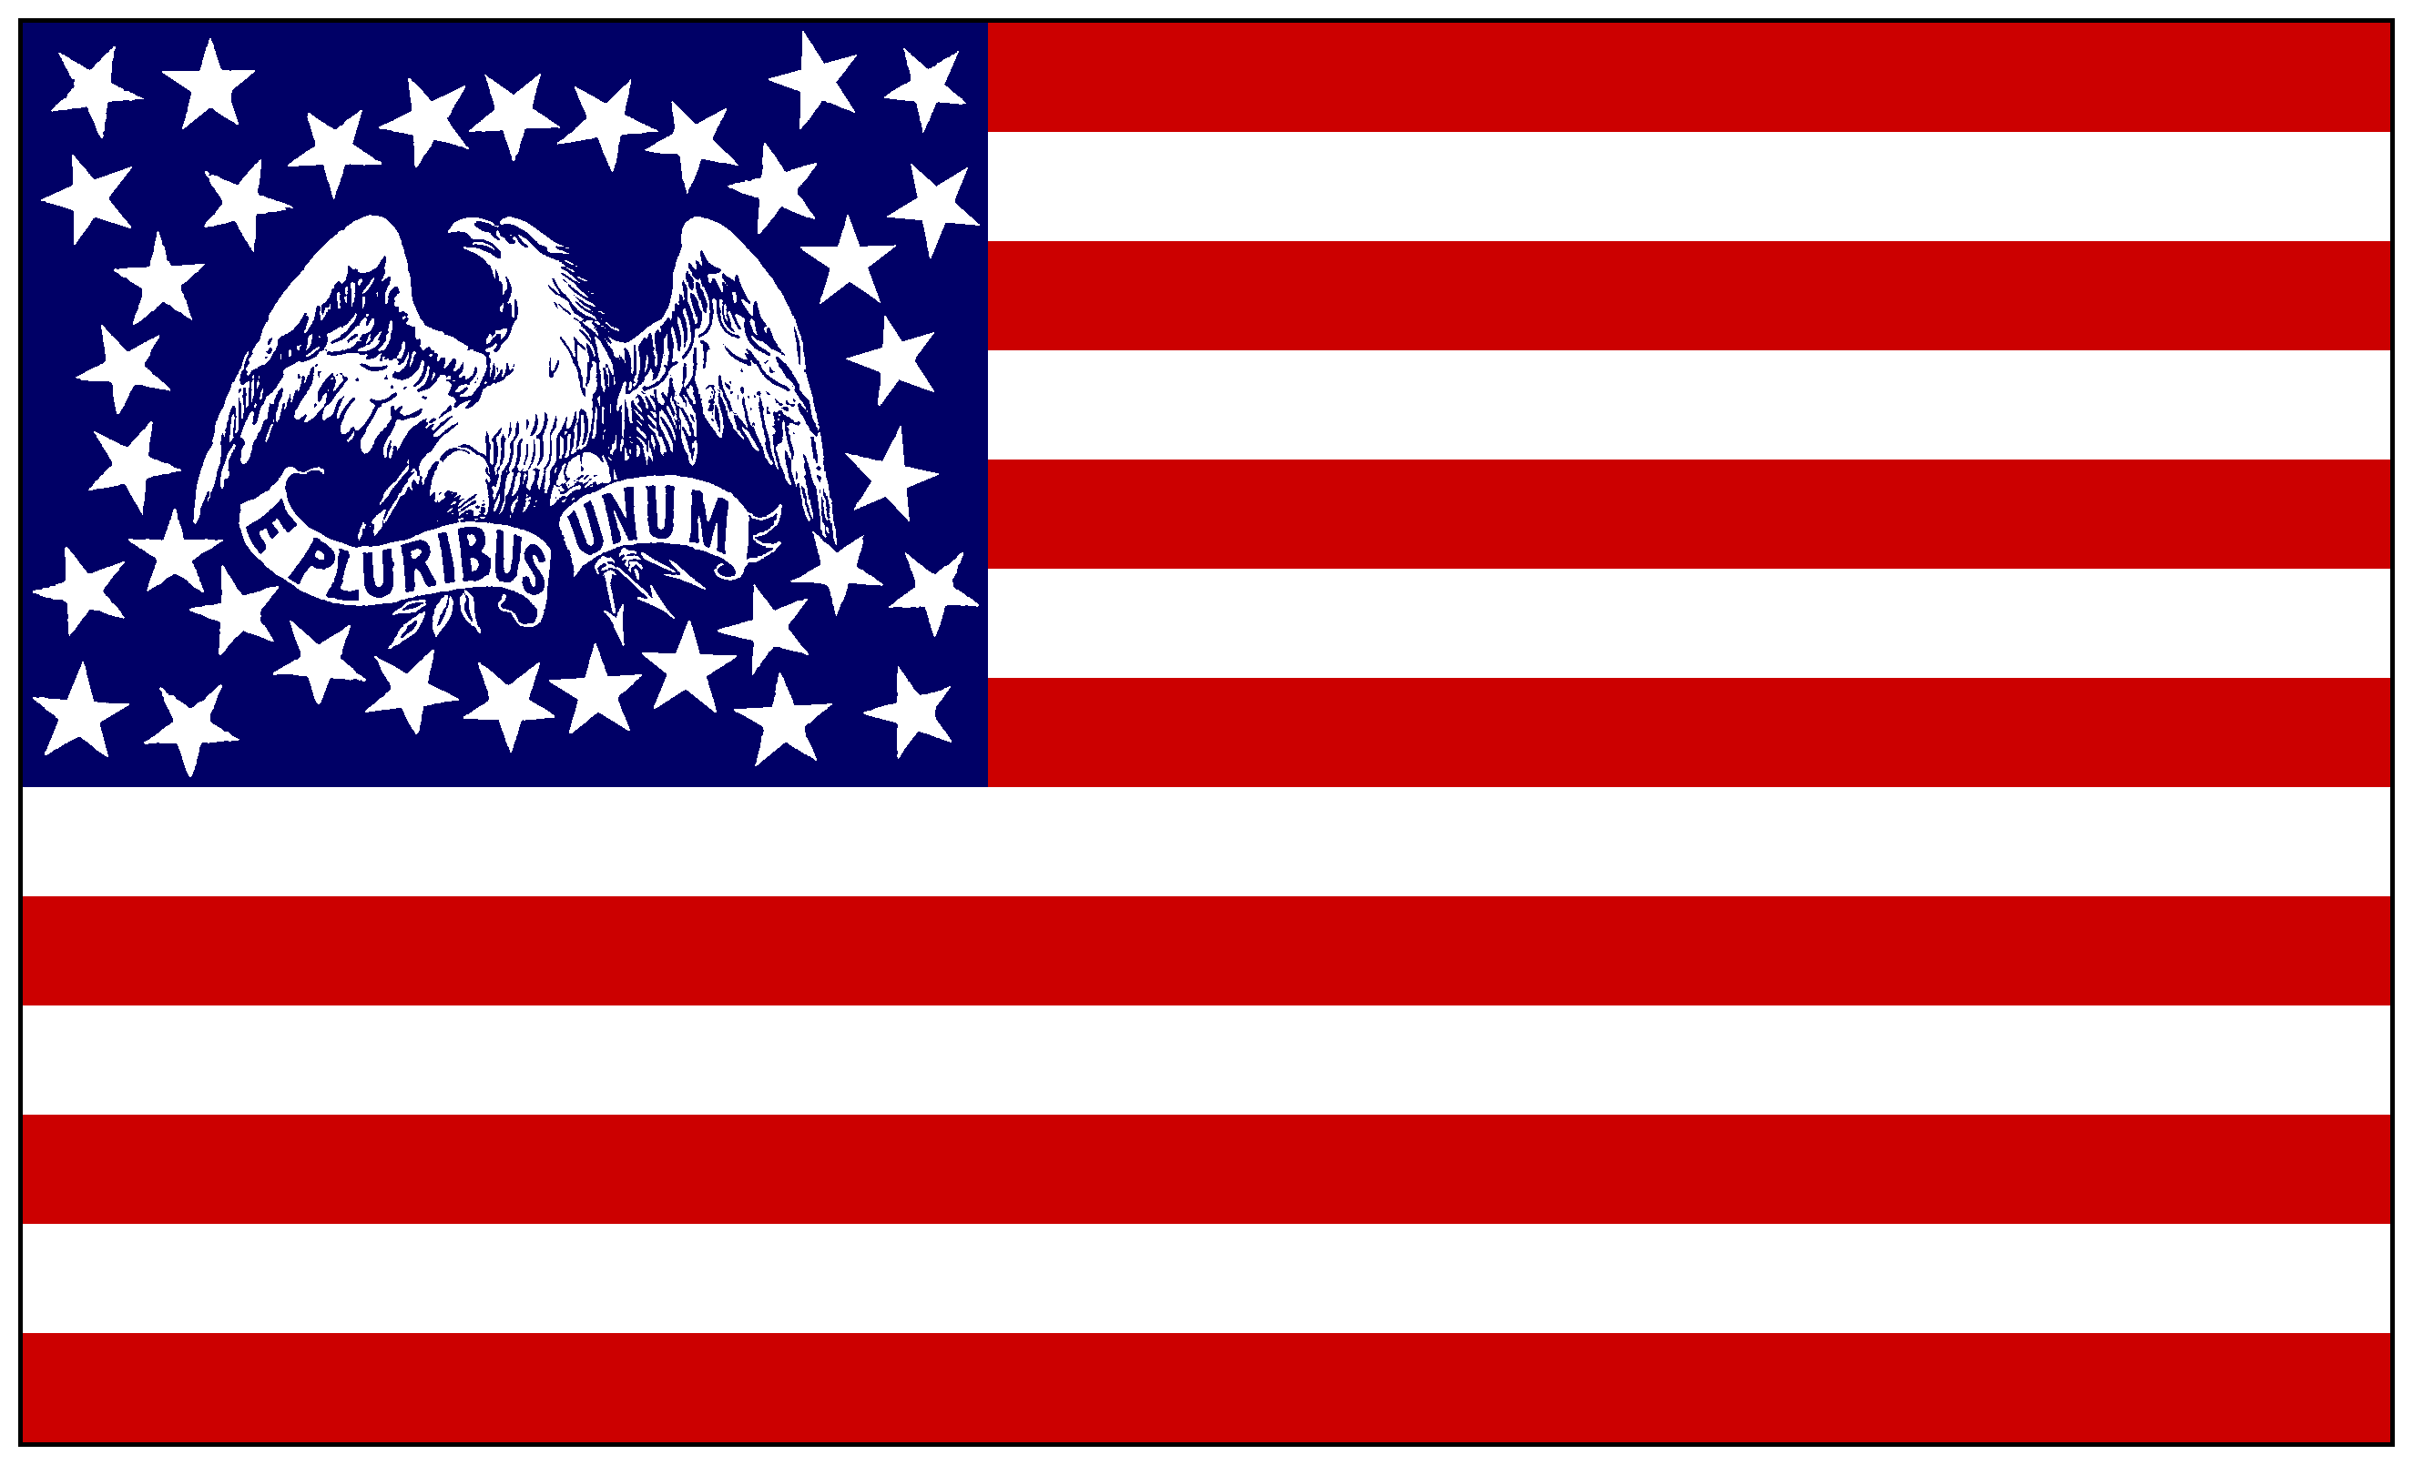
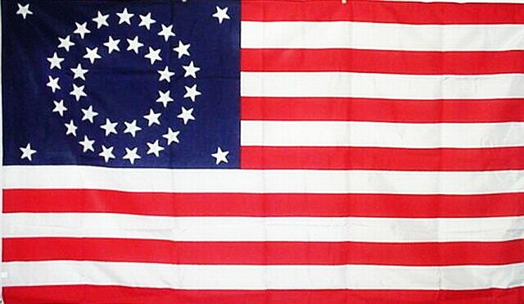
The North
Strengths
More people (22 million)
85% of all factories located in the North (Could make more and better supplies)
More railroads, naval ships, weapons, and supplies, telegraph.
More $ - could pay their troops
More farm land
Lincoln
Weaknesses
Most of the war was to be fought in the South.
Many Northern soldiers were not fighting to end slavery.
Most soldiers were young and inexperienced and looking for adventure.
Generals

Slide 7
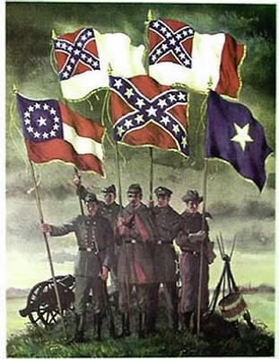
The South
Strengths
Great leaders and generals (Robert E. Lee)
Fighting a defensive war (home field advantage, knew the land)
They were fighting for a purpose – a way of life.
Weaknesses
Few factories to make supplies
Smaller population (12 million and 4 million were slaves)
Poorly equipped and lack of supplies – many men had to supply their own weapons/equipment and food.

Slide 8
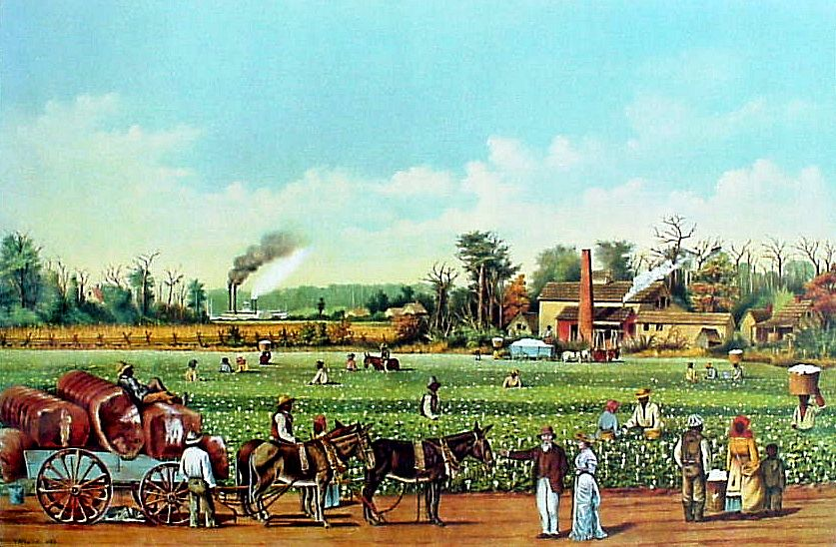
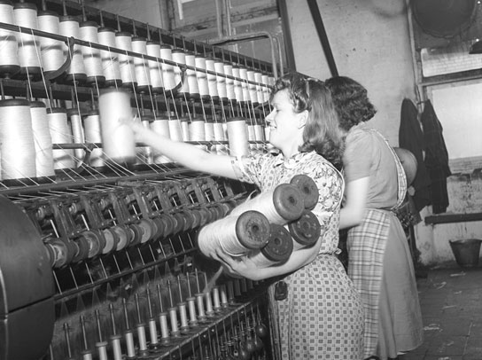
Both the North and South would be hurt by this war
The North relied on the South for their cotton to run their textile factories and food to feed their huge population.
The South relied on the North to buy their cotton and food to make a living.

Slide 9
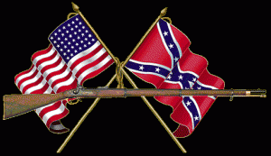
Strategies/Goals of the War
The North
Goal: Restore the Union not to end slavery.
Strategy: Anaconda Plan by Winfield Scott
Blockade or close Southern Ports
Control the Mississippi
Capture Richmond
The South
Goal: Be independent.
Strategy: Defensive War.
1. Let the war come to them.
2. Figured the North would tire of the war and find it too costly.
3. Get France and/or Great Britain to help.

Slide 10
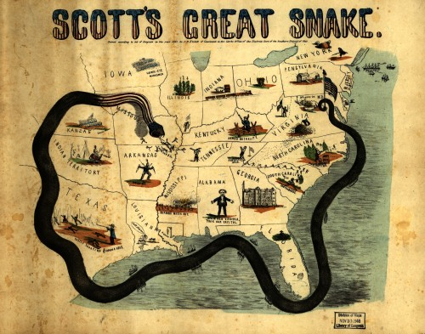
Anaconda Plan

Slide 11
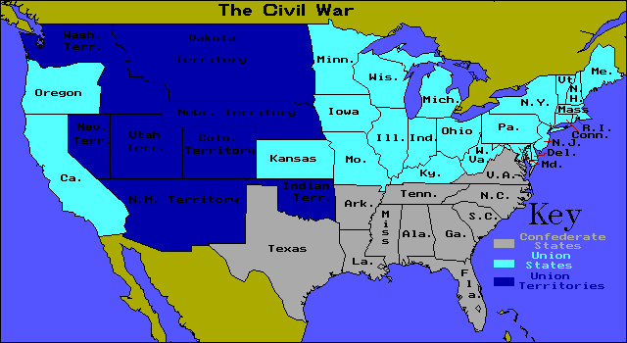

Slide 12
Why was this war more personal than any other in American history?
In border states you literally had brother fighting brother, cousin fighting cousin…etc.
Same history, same country…etc.
Leaders were classmates, friends…etc.
What led so many to enlist and fight in the war?
Obligation to defend their side, didn’t want to look weak.

Slide 13
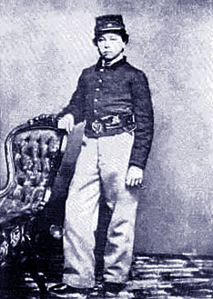
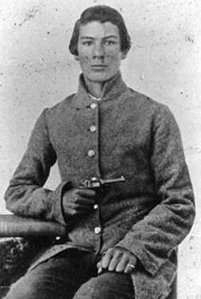
Soldiers of the war Age:
Average age was the mid-20s
Tens of 1000s were under the age of 18.
Some were younger than 14.

Slide 14
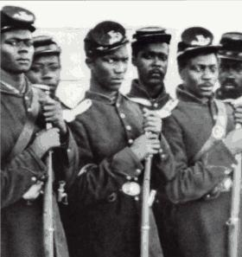
Soldiers: Minorities
Early in the war African-Americans were not allowed to fight. Eventually, the North changed this policy, but the South waited until the very end of the war.
200,000 African Americans, and 10,000 Mexican Americans fought for the Union during the war.

Slide 15
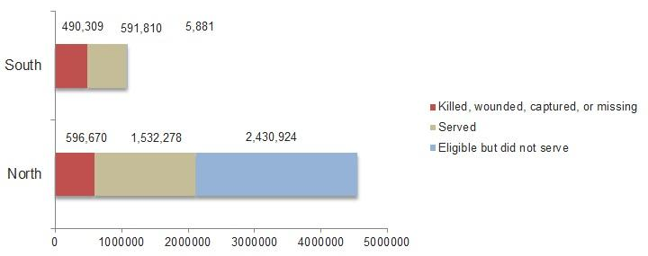
Soldiers: Totals
By the end of the war 900,000 men fought for the Confederacy. Those soldiers were called Rebels by the North.
By the end of the war 2.1 Million men fought for the Union. Those soldiers were called Yankees by the South.
Most soldiers were farmers making up ½ of the Union army and 60% of the South.

Slide 16
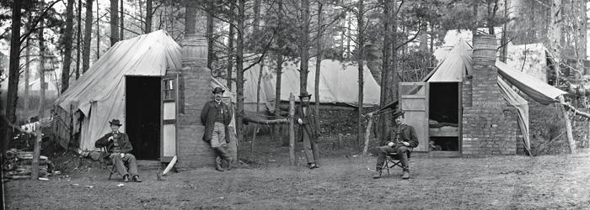
Camp Life
Describe some of the positive and negative parts of camp life, where they spent the vast majority of their time.
Positives: Letters from home, songs, stories, baseball games.
Negatives: dull routine, drills, bad food, marches, rain.
Desertion was a big issue for both sides. About 1 of every 11 Union and 1 of every 8 confederates ran away.

Slide 17
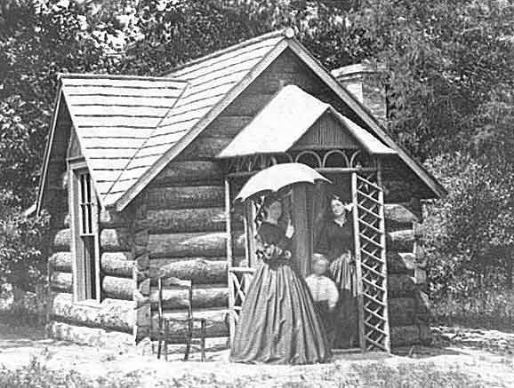
Life at Home
Why was life more difficult in the South than the North during the war?
Most of the war was fought in the South, more destruction, lost crops and homes, many displaced, food and supply shortages.

Slide 18
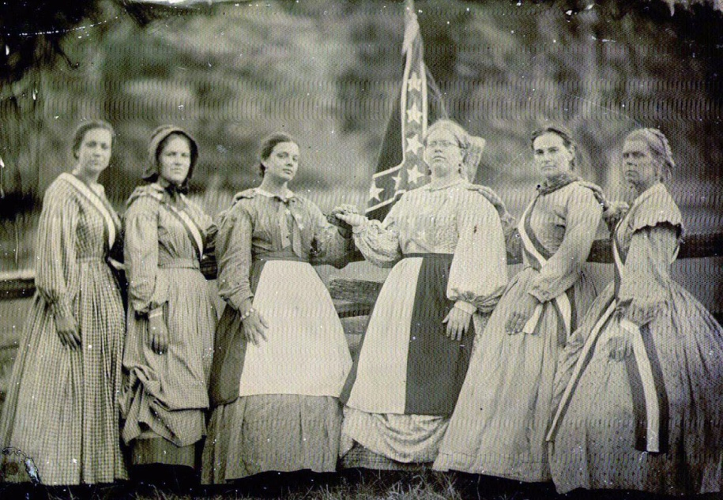
Life at home: Women
What was life like for most women who were left at home during the war?
Kept farms and factories going, ran offices, taught school, kept governmental records, suffered from stress and loss of loved ones, thousands served as nurses, and some even fought.

Slide 19
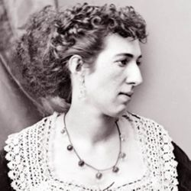
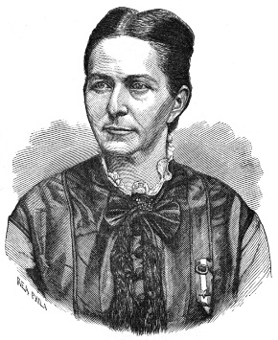
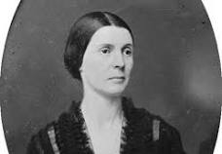
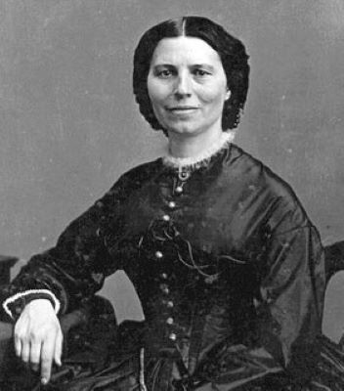
Women continued
Select one of the following women who served as a nurse and describe her experience below: Clara Barton, Dorthea Dix, Mary Edwards Walker.
Select one of the female spies/soldiers from the text and describe her contribution:
Rose O’Neal Greenhow
Belle Boyd
Frances Clayton
Harriet Tubman
Loreta Janeta Velazques

Slide 20
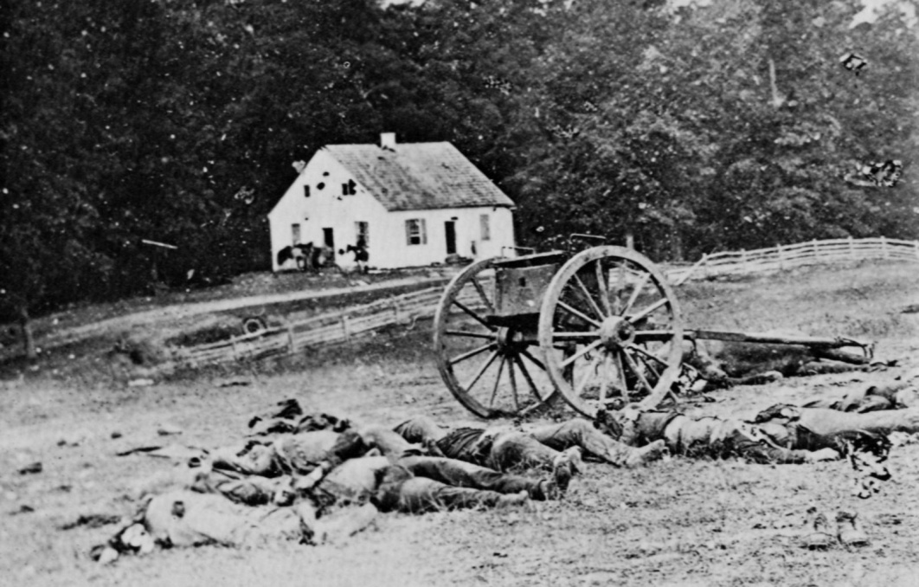
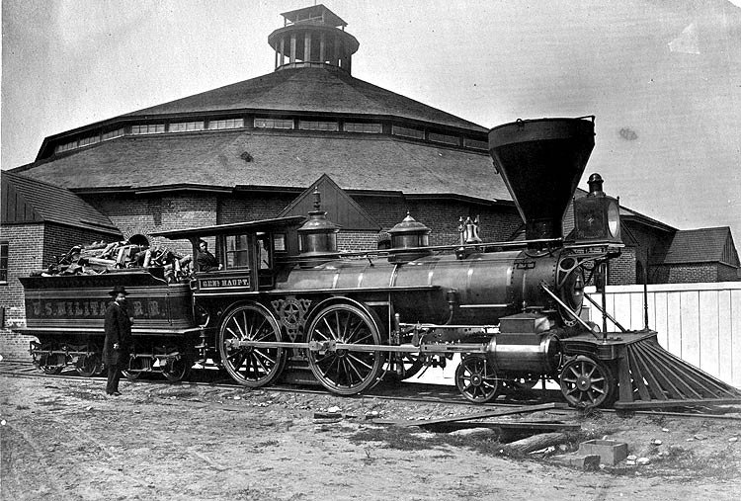
New Technology
The Civil War has also been called the 1st modern war because it was the first war to take place after the Industrial Revolution.
First war to be photographed – thousands of pictures taken by – Matthew Brady – famous photographer of the war.
Railroads were 1st used to transport troops and supplies

Slide 21
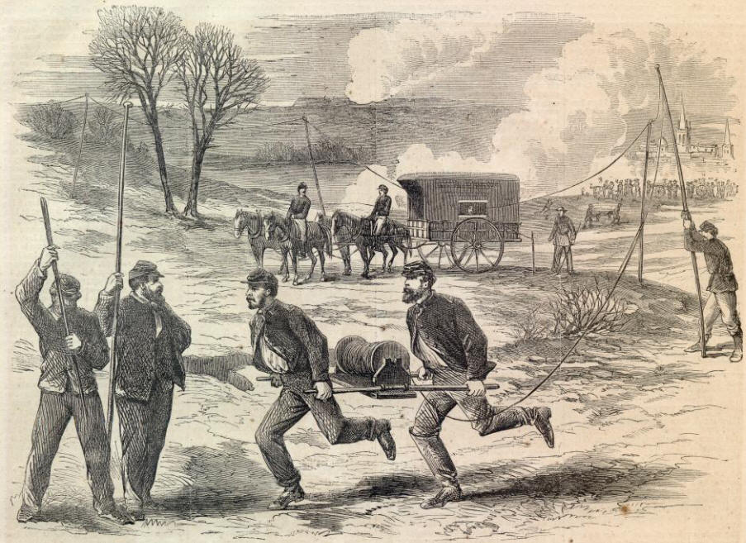
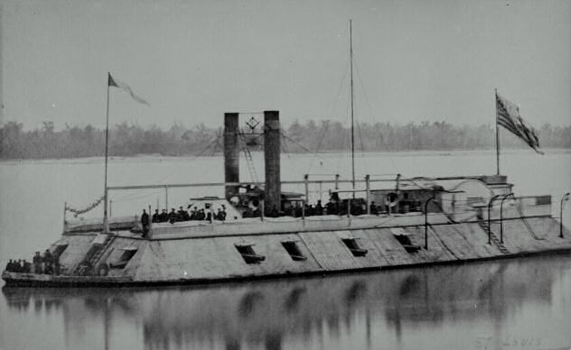
Technology Continued
3. Telegraphs were sometimes used for communication – lines often cut though
4. Ironclad ships were used for the 1st time instead of wood ships.

Slide 22
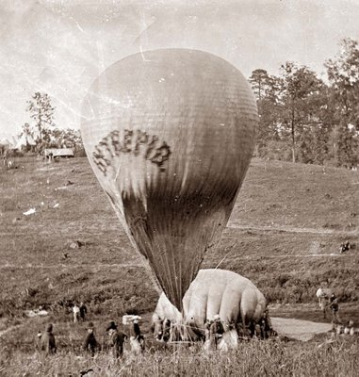
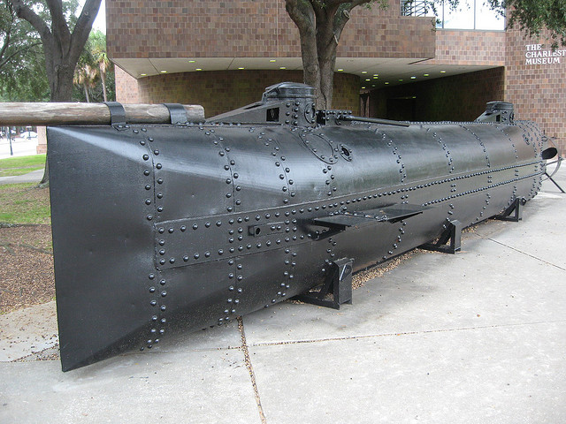
Technology Continued
5. Hot Air balloons for spying
Submarines which used torpedoes (Naval Mines) CSS Hunley
Trench Warfare – dug in positions

Slide 23
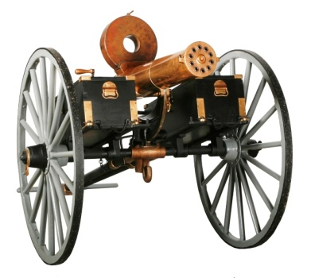
8. New Weapons
Long ranged rifles replaced the short-ranged musket- Most commonly used weapon among the infantry
Hand grenades- hardly ever used – did not work well.
Carbine rifles – used cartridges (breech loading/lever action) instead of the step-by-step muzzle loading – very expensive – not many used in Civil War, but common after the war.
Land Mines and Under water mines
Machine Guns –Gatlin gun (not used much)
Minie ball- new slug used for rifles- expanded and used rifling to spin- could shoot 600 yards accurately up to 1000 yards, the main reason for higher death rates.

Slide 24
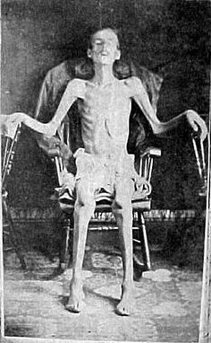
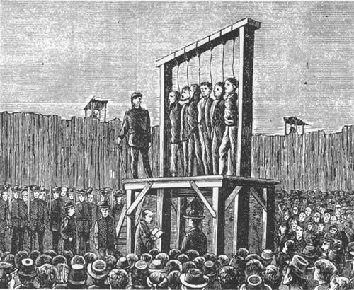
VII. Prisons Camps
At first each side would Exchange prisoners.
Eventually, each side set up prison camps.
The biggest issue was the food shortage

Slide 25
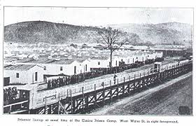
Prison Camps Continued
Andersonville was the worst prison camp in the South. It was built to hold only 10,000 prisoners, but eventually 33,000 were imprisoned at the same time. Almost 13,000 Union prisoners died there, mostly of disease.
Elmira was the worst camp in the North. Almost ¼ died due to cold temps, and disease from drinking water from a pond that was also used as a toilet and for garbage.

Slide 26
Civil War Medicine
Medical practices were very primitive compared to today’s standards
Not much for pain medicine – chloroform, alcohol, ether, or the brand-new drug morphine.
Disease was the #1 killer in the Civil War – dysentery killed more than anything else
No antibiotics yet
If you were wounded – amputation – the cutting off of limbs – was usually the treatment to prevent infection (gangrene)

Slide 27
VIII: Terminology
Copperheads- People who opposed the Civil War.
Cavalry-horse back soldiers-wore a yellow band
Infantry-Foot soldiers –wore a light blue band
Artillery-Cannons or big guns-wore a red band
“Napoleon”-Most popular cannon
Yankee (Billy Yank)-nickname for Union soldiers
Rebel (Johnny Reb)- Confederate soldier nickname

Slide 28
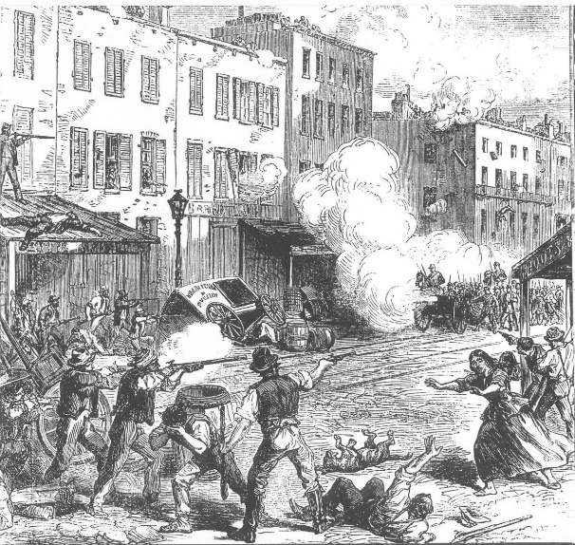
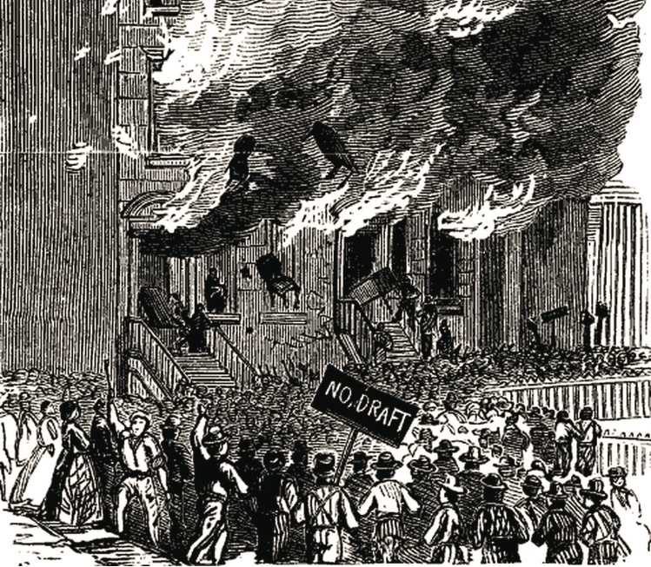
Draft
Required able-bodied white men between the ages of 20-45 in the North to register.
If selected, you had to serve in the war unless you could pay $300 bounty. Led to a belief that it was a “rich man’s war, but a poor man’s fight”.
Also, led to draft riots in New York City July 1863, where at least 100 and possible over 1000 were killed.

Slide 29
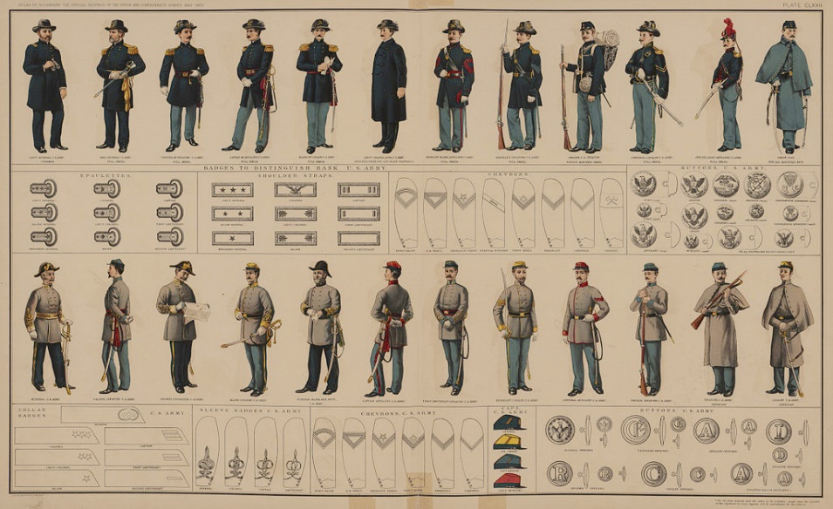
Military Terms/Divisions
Military Division | Definition | Leader
Squad | Consisted of 4-10 soldiers | Sergeant
Platoon | 5+ Squads, usually 50 soldiers | Lieutenant
Company | 2 Platoons | Captain
Regiment | 10 Companies | Colonel
Brigade | 4-5 Regiments | Brigadier General
Division | 4-5 Brigades | Major General
Corps | 3 Divisions | Lieutenant General

Slide 30
Civil War Statistics
Bloodiest War in U.S. history
Union Deaths =365,000+
+
Confederate Deaths=290,000+
Total Deaths in the Civil War=655,000+
% of the population 2%
In today’s population, that would be 6.6 Million people!
-If you added all of our wars French & Indian, Revolutionary, War of 1812, Mexican War, Spanish/American War, WWI, WWII, Korean War, Vietnam War, and our current wars the total number of deaths would be 699,000 which is only 44,000 more than the Civil War.
-If you do the same for total casualties, the Civil War was 1,130,000 and all other wars combined are 1,720,000.
2. 2.09% of the Entire US population killed compared to .31% in WWII.

Slide 31
Civil War Statistics Cont.
There was an estimated 10,500 engagements fought during the Civil War. 50 of these were considered “Major” battle, and about 100 were considered “significant”. A few were even fought in SD as part of the Dakota War against Native Americans.
U.S. Debt after the war = $5.2 Billion+

Slide 32
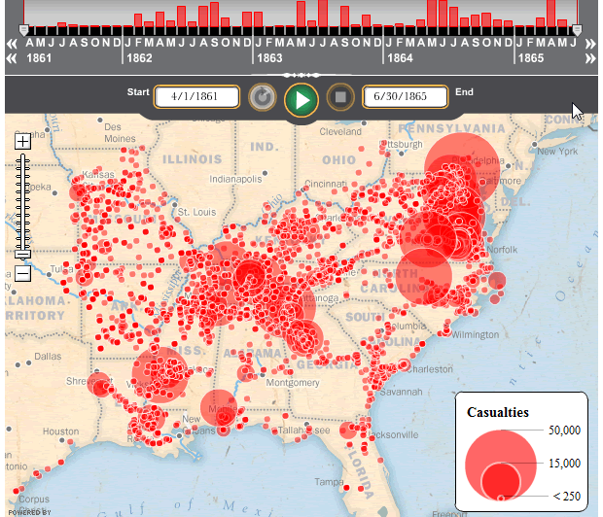

Slide 33
Deaths in American Wars
The numbers of Civil War dead were not equaled by the combined toll of other American conflicts until the War in Vietnam. Some believe the number is as high as 850,000

Slide 34
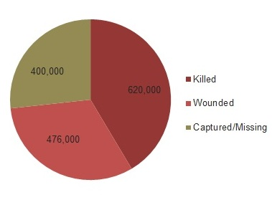
1.5 Million Casualties!!!

Slide 35
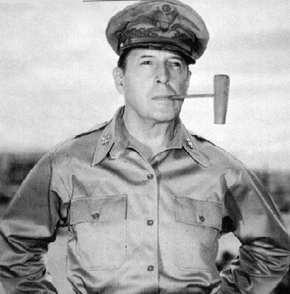
Military Rank
Private
Corporal
Sergeant
Lieutenant
Captain
Major
Colonel
General (Based on the Star System 6 is highest so far)

