Slide 1
Texas Revolution Projects
Examples

Slide 2
Quote Poster/Propaganda Poster

Slide 3
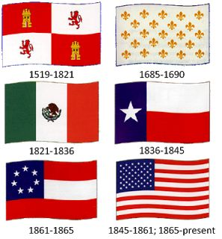
Flags of Texas Poster

Slide 4
Leaders of the Revolution Poster

Slide 5
State…of Texas Poster

Slide 6
Important Places of the Revolution

Slide 7
Stars of Texas Poster

Slide 8
ABC’s of the Texas Revolution Poster

Slide 9
Battle Posters

Slide 10
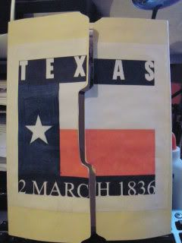
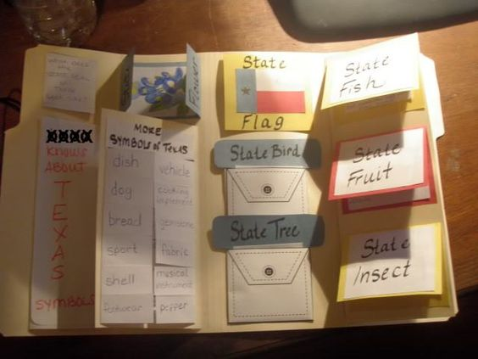
Interactive Notebook

