Slide 1
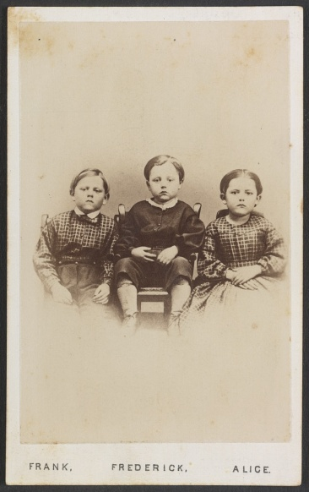
Home front
Life at home in both the North & South
Children of Sgt. Amos Humiston, 154th New York

Slide 2
Life Before the War
Economically the country was emerging from the financial crisis of 1857
The United States was solidifying its position on the North American continent with the admission of Oregon as the 33rd state in 1859
The U.S. boasted one of the best educated populations in the world with literacy rates toping 50% by 1860

Slide 3
One Nation – Two Directions
Urban centers were emerging primarily in the North
The Northern and Southern economies were moving in vastly different directions
Over 90% of the nation’s manufactured goods were produced in the North
In 1860, cotton accounted for 57% of all U.S. exports, the South produced an estimated 5,335,439 bales of cotton in 1860 or about 2,134,175,600 pounds

Slide 4
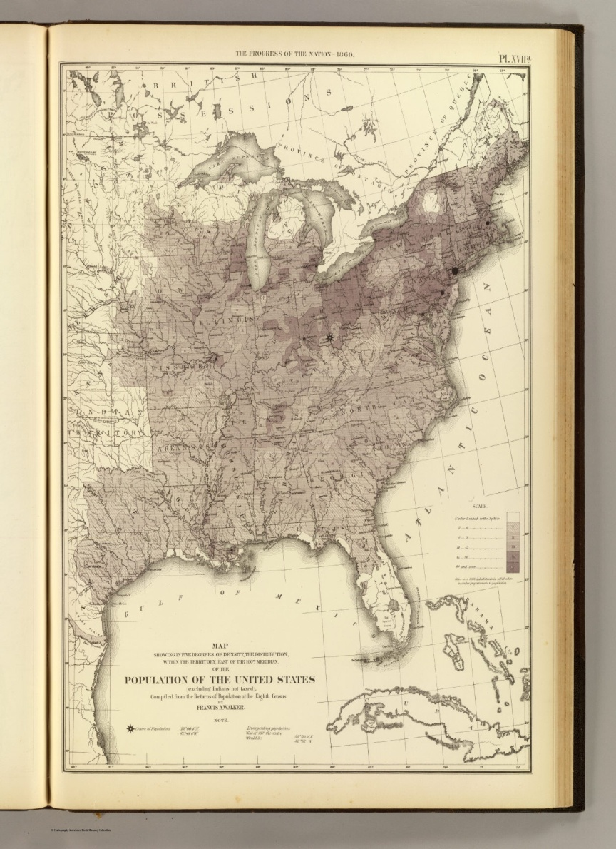
Population
In 1860 the nation’s total population numbered slightly over 31-million
Northern pop. – About 21.5 million
Southern pop. – About 5.5 million
Slaves – About 4-million
Men of military age (18-45)
North – 4,755,859
South – 868,206
Population distribution
Heaviest concentration of whites,
New England and Ohio River Valleys
Heaviest concentration of African-
Americans through the lower South
(Cotton-belt)

Slide 5
Family
In 1860, the average couple got married in their early to mid-twenties
The average male worker received $1.35 per day for 11 hours of labor
They typically had between 6-7 children, down from the average of 8-9 in 1800
Infant mortality was a problem throughout the nation

Slide 6
The War Begins
Between April and December 1861, the army expands from slightly over 16,000 to 660,000; a 44 fold increase
In the South, the initial call up of 100,000 was expanded to 400,000 by January of 1862
By the end of the War its believed that more than 3 million men wore the blue or grey uniform

Slide 7
Feeding a Family
Prior to the War, food prices throughout the country were fairly uniform with minor variations depending upon location and availability.
In the North prices rose steadily topping out in 1863 at double or triple their pre-War prices.
In the South, food prices spiraled out of control and continued to increase as the War dragged on
By 1864 prices in the South had in some cases risen 1000%

Slide 8
Civil War Inflation – Food Prices Skyrocket in the North – New York City Market
1861
Eggs = 15 cents per dozen
Cheese = 20 cents/lb
Bacon = 28 cents/lb
A Peck of apples (10-12 lbs) = $1.00
1863
Eggs = 25 cents per dozen
Cheese = 50 cents/lb
Bacon = $1.25 per lb
A Peck of apples (10-12 lbs) = $2.50

Slide 9
Social Life
The absence of husbands and fathers didn’t mean that business at home ceased, women and children were forced to take over businesses, supervising farms, and in the South managing plantations
Besides its spiritual connections the church provided a social outlet for families to connect and share information about loved ones
Wanting to feel more involved in the War effort, many women volunteered their skills as seamstresses to help make clothing or to work in hospitals helping the wounded
To take their minds off the war, citizens both North & South visited carnivals, played baseball, attended parties & ball’s, began the bicycle craze, and attended musical concerts

Slide 10
Staying connected
Letters to a loved one provided a precious link between life in camp or on the battlefield and home
Understanding its importance to morale, the army assigned personnel to collect, distribute, and deliver the soldiers’ mail; wagons and tents were employed as mobile post offices
The Confederacy established its own Post Office Dept. in February of 1861 and named former U.S. Congressman John Henninger Reagan as the Postmaster General
The exchange of mail between the North and South was banned in August of 1861 except under flag of truce

Slide 11
Returning those who were lost
Identification of those who had fallen was poor
This is the first time that many fallen soldiers are returned to their families thanks to the practice of embalming
After the War ended, the Nation's veterans assistance program was expanded to include benefits and pensions not only for veterans, but also their widows and dependents

Slide 12
The war will change America and families forever
Roughly 2.3 percent of the entire US population died in the Civil War
Families would be fatherless
Mothers would have one or more less sons
The work force will require women to fill the needs
Reconstruction will take years to TRY to rebuild America

